Slide 1
Doctrinal Mastery Helps Spring 2021 Doctrine & Covenants / Church History
JS-H 1:15-20
D&C 1:30
D&C 1:37-38
D&C 6:36
D&C 8:2-3
D&C 13:1
3rd Term Quiz
D&C 18:10-11
D&C 18:15-16
D&C 19:16-19
D&C 21:4-6
D&C 29:10-11
D&C 42:11
D&C 49:15-17
4th Term Quiz

Slide 2
A Little Explanation
With Doctrinal Mastery, although memorization is not emphasized as it was, we are still to help our students know the passages, understand them, and help them be able to know the references to the passages. By studying the Doctrinal Mastery Materials, you will see that they give time to each topic according to how many Doctrinal Mastery Passages there are for that topic. In other words, you can take a week to spotlight each passage and help your students get to know that passage better.
To spotlight a scripture for the week, it takes about 5 minutes each day. It is good to have the class recite the verse in unison each day (first slide). Then do one of the following on different days.
Ask the class why that verse is important and why it was chosen. How does it support the Doctrinal Mastery Topic? Have them highlight the verse(s) in their scriptures, and underline key words
Share the mnemonic (second slide). See helps to sharing a mnemonic on the next slide.
Share a scenario, questions, or some activity to help them explain and apply the doctrine. With this they can discuss or roleplay with their partner (third slide).
There are about 36 weeks in a school year and 25 Doctrinal Mastery Passages, so you can review and quiz with the students to help them on weeks without a passage, or spend extra time on some passages. We might also look at Doctrinal Mastery Passages from other years. I have also included as quiz and review after ever 6 or 7 passages learned.

Slide 3
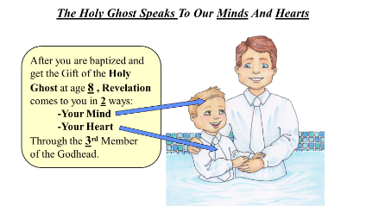
Steps To Using The Doctrine & Covenants Doctrinal Mastery Mnemonics
Keep the key words of the scripture in mind (especially the underlined words).
Link the key words to an idea or image in the cartoon mnemonic.
Link the idea to the reference embedded in the cartoon mnemonic.
Practice with a friend, with them saying the key words, and you giving the reference.
Give hints from the mnemonic.

Slide 4
JS-H 1:15-20
The Restoration
15 After I had retired to the place where I had previously designed to go, having looked around me, and finding myself alone, I kneeled down and began to offer up the desires of my heart to God. I had scarcely done so, when immediately I was seized upon by some power which entirely overcame me, and had such an astonishing influence over me as to bind my tongue so that I could not speak. Thick darkness gathered around me, and it seemed to me for a time as if I were doomed to sudden destruction.
16 But, exerting all my powers to call upon God to deliver me out of the power of this enemy which had seized upon me, and at the very moment when I was ready to sink into despair and abandon myself to destruction—not to an imaginary ruin, but to the power of some actual being from the unseen world, who had such marvelous power as I had never before felt in any being—just at this moment of great alarm, I saw a pillar of light exactly over my head, above the brightness of the sun, which descended gradually until it fell upon me.
17 It no sooner appeared than I found myself delivered from the enemy which held me bound. When the light rested upon me I saw two Personages, whose brightness and glory defy all description, standing above me in the air. One of them spake unto me, calling me by name and said, pointing to the other—This is My Beloved Son. Hear Him!
Notes:
Because this is such a LONG Doctrinal Mastery, it might be good for them to only read verses 15-17 on one week, and 18-20 on the next week.

Slide 5
JS-H 1:15-20
The Restoration
18 My object in going to inquire of the Lord was to know which of all the sects was right, that I might know which to join. No sooner, therefore, did I get possession of myself, so as to be able to speak, than I asked the Personages who stood above me in the light, which of all the sects was right (for at this time it had never entered into my heart that all were wrong)—and which I should join.
19 I was answered that I must join none of them, for they were all wrong; and the Personage who addressed me said that all their creeds were an abomination in his sight; that those professors were all corrupt; that: “they draw near to me with their lips, but their hearts are far from me, they teach for doctrines the commandments of men, having a form of godliness, but they deny the power thereof.”
20 He again forbade me to join with any of them; and many other things did he say unto me, which I cannot write at this time. When I came to myself again, I found myself lying on my back, looking up into heaven. When the light had departed, I had no strength; but soon recovering in some degree, I went home. And as I leaned up to the fireplace, mother inquired what the matter was. I replied, “Never mind, all is well—I am well enough off.” I then said to my mother, “I have learned for myself that Presbyterianism is not true.” It seems as though the adversary was aware, at a very early period of my life, that I was destined to prove a disturber and an annoyer of his kingdom; else why should the powers of darkness combine against me? Why the opposition and persecution that arose against me, almost in my infancy?
Notes:
Because this is such a LONG Doctrinal Mastery, it might be good for them to only read verses 15-17 on one week, and 18-20 on the next week.

Slide 6
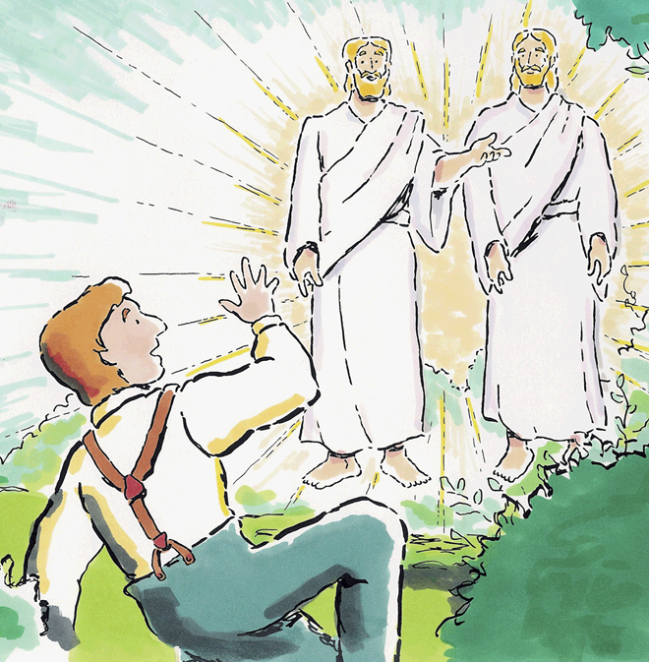
In The First Vision, God Called Joseph Smith To Be A Prophet
In Joseph Smith’s History the 1st Vision may have lasted about 15-20 minutes.
Notes:
Where is the best book to go to learn about Joseph Smith’s Vision? (Joseph Smith – History)
What is the name of this Vision? (First Vision). What chapter does that mean? (Chapter 1).
Did you know it may have only taken 15 to 20 minutes? (Verses 15-20)

Slide 7
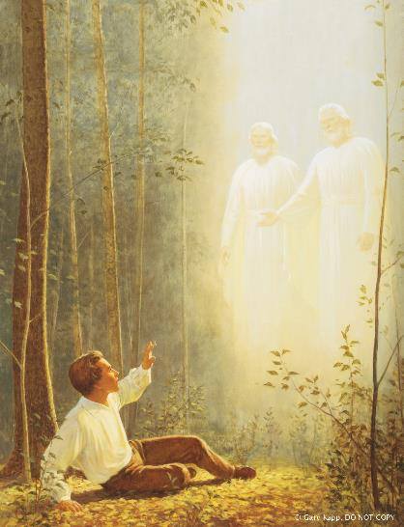
Explain and Apply Doctrine:
Try to write one sentence that answers all the following five questions. Share with your partner.
Who appeared?
To whom did they appear?
Why did they appear?
What did they do after they appeared?
Where in the scriptures is this account found?

Slide 8
The Daily Dilemma
Your friend Brandon is a member of the Church who seems to have become disinterested with anything Church related. After noticing this for a few weeks, you bring it up in a private conversation with him. Brandon shares with you that he recently learned that Joseph Smith used four different firsthand accounts to describe his First Vision. He is concerned because he feels like some of the details in these accounts differ from one another. He now wonders if the First Vision happened at all. He asks, “How can I believe in Joseph Smith and the Restoration if there are different accounts of the First Vision?”
Notes:
Example of a person telling of their engagement. Would it matter if a week later, or telling your own child later, or some friends? If you ask the spouse, will the account differ?
The 4 Gospels differ in the details they share of each story.

Slide 9
D&C 1:30
The Restoration
30 And also those to whom these commandments were given, might have power to lay the foundation of this church, and to bring it forth out of obscurity and out of darkness, the only true and living church upon the face of the whole earth, with which I, the Lord, am well pleased, speaking unto the church collectively and not individually—

Slide 10
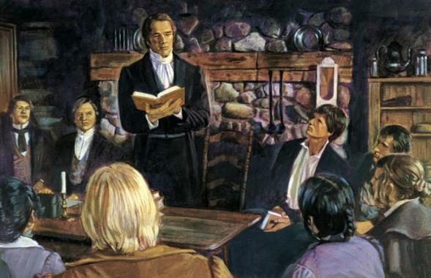
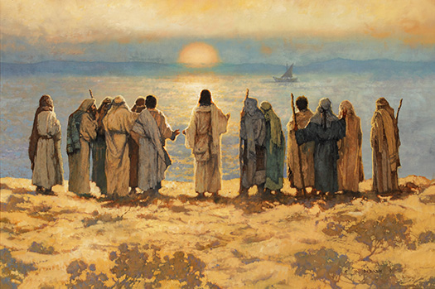
The Only True And Living Church
There is only 1 True and Living Church upon the Earth today. Jesus Christ’s Church was Restored in the year eighteen-30.
Notes:
So how many true churches is this verse saying there is? (Section One)
What year was the Church Restored in this dispensation?

Slide 11
The Only True And Living Church
There is only 1 True and Living Church upon the Earth today.
When Jesus was 30, He started His ministry that established His Church upon the Earth in the New Testament time period.
Notes:
So how many true churches is this verse saying there is? (Section One)
How old was Jesus when he started to establish the True Church in the New Testament? (Verse 30)

Slide 12
The Daily Dilemma
Diana and Clark are walking to school one morning when Clark turns to Diana and says, “We’ve been good friends for a long time, so don’t take this the wrong way, but why do you Mormons say you belong to the true church? Don’t you think it’s arrogant to say your religion is true and everyone else’s religion is false?” Diana feels surprised by this question and had not considered that saying the Church is true might imply that all other churches are false.
Discuss with your partner what you think is the intent of Clark’s comment to Diana. How would you summarize his feelings and beliefs?
Take a few minutes to role-play with your partner how you would respond to Clark’s concern if you were Diana.
Notes:
So what does it mean that The Church of Jesus Christ of Latter-day Saints is the only true Church?
Three features—(1) fulness of doctrine, (2) power of the priesthood, and (3) testimony of Jesus Christ—explain why God has declared and why we as His servants maintain that this is the only true and living Church upon the face of the whole earth. …
… This Church is “living” because we have prophets who continue to give us the word of the Lord that is needed for our time. (Dallin H. Oaks, “The Only True and Living Church,” New Era, Aug. 2011, 3, 5)

Slide 13
D&C 1:37-38
Prophets and Revelation
37 Search these commandments, for they are true and faithful, and the prophecies and promises which are in them shall all be fulfilled.
38 What I the Lord have spoken, I have spoken, and I excuse not myself; and though the heavens and the earth pass away, my word shall not pass away, but shall all be fulfilled, whether by mine own voice or by the voice of my servants, it is the same.

Slide 14
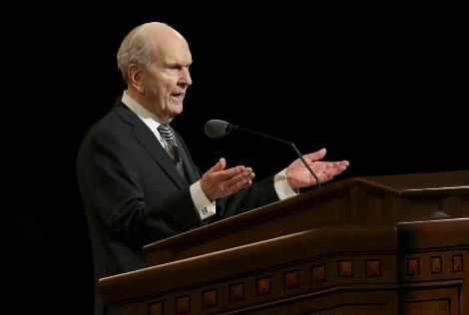
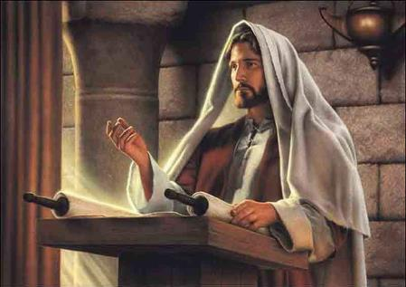
The Voice Of The Lord And His Servants Is The Same
The Lord and His Servants speak with 1 Voice.
You can Search these commandments and find that most of their words will be fulfilled by the time you are 37-38 years old.
Notes:
How many voices does the Lord and His servants speak with? (one voice, Section 1)
How old do you need to be to see these things fulfilled? (37-38)

Slide 15
The Voice Of The Lord And His Servants Is The Same
The Lord and His Servants speak with 1 Voice. Searching these commandments will help you get to the “Purdy Heaven” (37) and enter the “Pearly Gate” (38).
Notes:
How many voices does the Lord and His servants speak with? (one voice, Section 1)
Purdy Heaven rhymes with?
Pearly Gate rhymes with?

Slide 16
The Daily Dilemma
Your friend is wondering about what is the big deal about watching General Conference.
How could this scripture help in this discussion?
Roleplay the situation using this scripture.

Slide 17
The Daily Dilemma
During a group chat, some of your friends who are members of the Church share various opinions about certain behaviors. Some think they are wrong while others don’t think so because they have not heard the prophet speak directly about them. You know that the prophet actually has spoken about the behaviors they are discussing. You wonder how you should respond.
How could the “For Strength of Youth” pamphlet help?
Pick a topic in the pamphlet and role play it with the situation above

Slide 18
D&C 6:36
Acquiring Spiritual Knowledge
36 Look unto me in every thought; doubt not, fear not.

Slide 19
Look Unto Christ In Every Thought
I wish I could have Every Thought be about Christ.
I only get between 6 to 36 thoughts in an hour.
I also had another Thought: 6 squared equals 36.
I have no Doubt or Fear about that truth.
Notes:
How many thoughts does that girl have an hour?
What is 6 Squared?

Slide 20
The Daily Dilemma
In our daily lives, endless reports of criminal violence, famine, wars, corruption, terrorism, declining values, disease, and the destructive forces of nature can engender fear and apprehension. Surely we live in the season foretold by the Lord: “And in that day … the whole earth shall be in commotion, and men’s hearts shall fail them” -Doctrine and Covenants 45:26. -David A. Bednar
What are some other doubts or fears that youth may have besides those mentioned by Elder Bednar?
How could this verse help?
What is the difference between asking questions and doubting?
How does focusing on Jesus Christ make everything better?

Slide 21
Explain and Apply Doctrine:
Have you memorized and can quote the verse?
Does this help? L U M I E T; D N, F N.

Slide 22
D&C 8:2-3
Acquiring Spiritual Knowledge
2 Yea, behold, I will tell you in your mind and in your heart, by the Holy Ghost, which shall come upon you and which shall dwell in your heart.
3 Now, behold, this is the spirit of revelation; behold, this is the spirit by which Moses brought the children of Israel through the Red Sea on dry ground.

Slide 23
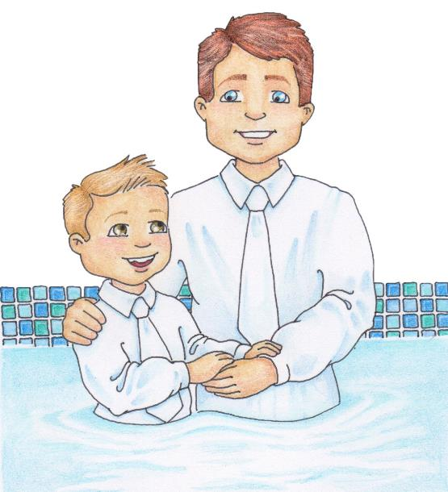
The Holy Ghost Speaks To Our Minds And Hearts
After you are baptized and
receive the Gift of the Holy
Ghost at age 8 , Revelation
comes to you in 2 ways:
-Your Mind
-Your Heart
Through the 3rd Member
of the Godhead.
Notes:
At what age should the Holy Ghost start speaking to us in a better way? (8 because of baptism).
How many places in our body will feel the Holy Ghost?
What member of the God head is the Holy Ghost?

Slide 24
The Daily Dilemma
Explain to a partner how the Holy Ghost might feel as your mind is touched? Share an experience if you feel comfortable.
Explain to a partner how the Holy Ghost might feel as your heart is touched? Share an experience if you feel comfortable.

Slide 25
The Daily Dilemma
How might the following people know if their thoughts are from the Holy Ghost or just random thoughts in their head?
Kailani’s friends are not always the best influence on her. Lately she has had thoughts that maybe she should try to make new friends who have higher standards.
Jon keeps having the idea to talk to his mom about some choices he has made that he regrets.
Marcus gets the idea to go to a concert with his friends. He knows his parents would not approve of this concert, so he has made a plan that will keep his parents from finding out where he will be.
Lisa has been thinking a lot about getting her patriarchal blessing lately. She wonders if now is the right time.

Slide 26
D&C 13:1
Priesthood & Priesthood Keys
1 Upon you my fellow servants, in the name of Messiah I confer the Priesthood of Aaron, which holds the keys of the ministering of angels, and of the gospel of repentance, and of baptism by immersion for the remission of sins; and this shall never be taken again from the earth, until the sons of Levi do offer again an offering unto the Lord in righteousness.

Slide 27
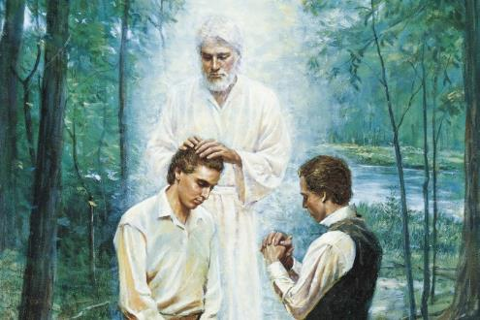
Keys of the Aaronic Priesthood
Previously, worthy young men could not receive the Aaronic Priesthood till their 13th year of life began. Receiving the Priesthood should be a #1 priority for a young man.
Notes:
At what year of life could a young man receive the Aaronic Priesthood? (Section 13)
Remind them that when a person turns 12, they are starting their 13th year of life.
Kind of like when a kid is 8 months old, he is in his 1st year of life.

Slide 28
Explain and Apply Doctrine:
In pairs, write down as many questions you can come up with, that relate to the verse.
Share with the class any questions you were not able to answer.

Slide 29
The Daily Dilemma
When with a friend, you mention how you missed seeing them at Church. They reply that they had been invited by another friend to go to a different church. When I asked how it went, they said… “It was fun. They have a good pastor. They teach about Jesus Christ and take the sacrament, only they call it communion. I am starting to think as long as I’m trying to get closer to the Lord, it doesn’t matter where I go to church and partake of the sacrament.”
What ideas might you want to share with them?
Role play the situation together.

Slide 30
D&C 18:10-11
The Atonement of Jesus Christ
10 Remember the worth of souls is great in the sight of God;
11 For, behold, the Lord your Redeemer suffered death in the flesh; wherefore he suffered the pain of all men, that all men might repent and come unto him.

Slide 31
The Worth Of Souls Is Great
An 18-year-old young man can see the Worth of Souls to God as a full-time missionary. That is 10 times (even 11 times) better than anything else he can do at that age.
Notes:
At what age can a young Man see the worth of Souls full time? (Section 18)
How many times better is that than anything else they could be doing? (Verses 10-11)

Slide 32
The Daily Dilemma
You have a friend who has been feeling discouraged lately. When you ask if something is wrong, she is reluctant to tell you, but she eventually admits that she has begun to doubt that God loves her. “Why does God seem to be so mindful of others but does not seem to care about me?”
In what ways might you encourage your friend to act in faith to resolve her concern?
How could you help your friend examine her concern with an eternal perspective?
How could you use Doctrine and Covenants 18:10–11 to help your friend?
What other scriptures or statements by prophets and apostles could you encourage your friend to read in order to seek further understanding of her worth to God? (Take a few minutes now to find some scriptures or statements that you might use.)

Slide 33
D&C 18:15-16
Commandments
15 And if it so be that you should labor all your days in crying repentance unto this people, and bring, save it be one soul unto me, how great shall be your joy with him in the kingdom of my Father!
16 And now, if your joy will be great with one soul that you have brought unto me into the kingdom of my Father, how great will be your joy if you should bring many souls unto me!

Slide 34
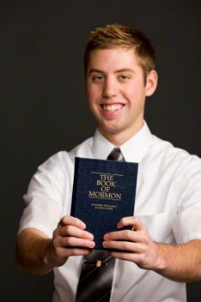
Joy In Bringing Souls To Jesus Christ
An 18 year-old young man can see the Great Joy that comes from Bringing Souls Unto Jesus as a full-time missionary. There is also Great Joy when a 15 year-old can take Drivers-Ed, so that when he is 16, he can help Bring Souls to Church in his car.
Notes:
Again, at what age can a Young Man start bringing Souls to Christ? (Section 18)
At what age can he start preparing to bring or drive souls to Church? (Verses 15-16)

Slide 35
The Daily Dilemma
Think about someone you would like to share the gospel with. This could be someone who is not a member of the Church or someone you would like to help become more active in the Church.
Have you ever experienced joy from sharing gospel teachings with someone else? Why do you think you felt this way?
Why do you think preaching the gospel is such an important duty?
What concerns do some people have about sharing the gospel?

Slide 36
D&C 19:16-19
The Atonement of Jesus Christ
16 For behold, I, God, have suffered these things for all, that they might not suffer if they would repent;
17 But if they would not repent they must suffer even as I;
18 Which suffering caused myself, even God, the greatest of all, to tremble because of pain, and to bleed at every pore, and to suffer both body and spirit—and would that I might not drink the bitter cup, and shrink—
19 Nevertheless, glory be to the Father, and I partook and finished my preparations unto the children of men.

Slide 37
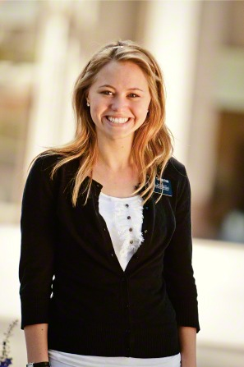
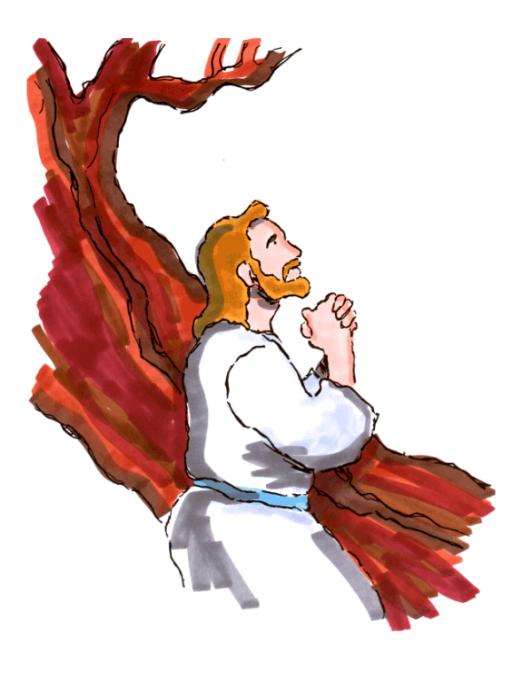
The Savior Suffered For Our Sins So We Could Repent
Christ Suffered more than anyone. Here on my mission (age 19), I help people repent. I see that missionary work is not suffering; the real suffering can be those dating years (16-19).
Notes:
At what age can a Young Woman start helping people learn how Jesus suffered so we can Repent? (Section 19)
When are often those suffering years of dating? (Verses 16-19)

Slide 38
The Daily Dilemma
Both these individuals attend school, enjoy their friends, and are members of The Church of Jesus Christ of Latter-day Saints. One of them understands and feels the importance of the Atonement of Jesus Christ, and the other does not. What difference would this make in their lives?

Slide 39
The Daily Dilemma
Jordan believes that Jesus Christ would be willing to forgive most people who repent, but he’s not sure the Savior’s Atonement would work for him. He keeps committing the same sin over and over and doesn’t think he’ll ever be able to overcome that sin.
According to verse 16, what must we do in order to be spared the kind of suffering the Savior experienced?

Slide 40
D&C 21:4-6
Prophets and Revelation
4 Wherefore, meaning the church, thou shalt give heed unto all his words and commandments which he shall give unto you as he receiveth them, walking in all holiness before me;
5 For his word ye shall receive, as if from mine own mouth, in all patience and faith.
6 For by doing these things the gates of hell shall not prevail against you; yea, and the Lord God will disperse the powers of darkness from before you, and cause the heavens to shake for your good, and his name’s glory.

Slide 41
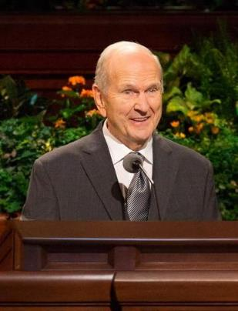
As We Receive The Prophet’s Word In Patience And Faith,
God Will Disperse The Powers Of Darkness
Receiving the Prophet’s Word about not drinking, or playing Black Jack (21) in Patience and Faith will help make your life 4-6 times brighter
21:
4-6
Notes:
What are some words of council the prophet has given us about drinking and BlackJack? (Section 21)
How many times brighter will that make your life? (Verses 4-6)

Slide 42
The Daily Dilemma
One of your friends from church comes to you one day because of some things she read on the internet. In an online discussion, people were talking about changes they want to see in The Church of Jesus Christ of Latter-day Saints. The people seemed to be frustrated with the Apostles and prophets because their views oppose those of many in the world and do not seem to change. This discussion seemed to include members of the Church and others who wanted to voice their opinions in order to pressure the leaders of the Church to make changes. She sounds confused and upset and asks, “Why don’t prophets listen to the people more?”

Slide 43
D&C 29:10-11
The Godhead
10 For the hour is nigh, and that which was spoken by mine apostles must be fulfilled; for as they spoke so shall it come to pass;
11 For I will reveal myself from heaven with power and great glory, with all the hosts thereof, and dwell in righteousness with men on earth a thousand years, and the wicked shall not stand.

Slide 44
Christ Will Come Again With Power And Glory
When Christ Comes Again, it might be on a Leap Year (29 days in February). To prepare for Christ’s return, we are to help gather the Lost 10-11 tribes.
-11
Notes:
What year might Jesus Come again? (Section 29)
How many tribes are we to help gather? (Verses 10-11)

Slide 45
The Daily Dilemma
April is a friend and fellow ward member. One day while you are hanging out with April, you hear about a disaster that recently happened. As you talk about the disaster, April brings up the Second Coming. The more April talks, the more you can tell she sounds really worried.
How might you use Doctrine and Covenants 29:10–11 to help someone who is concerned about the Second Coming?
How does verse 10 help?

Slide 46
D&C 42:11
Priesthood & Priesthood Keys
11 Again I say unto you, that it shall not be given to any one to go forth to preach my gospel, or to build up my church, except he be ordained by some one who has authority, and it is known to the church that he has authority and has been regularly ordained by the heads of the church.

Slide 47
The Lord’s Representatives Must Be
Called By One Who Has Authority
Those who teach need to be Called and have priesthood Aufority Too (42). A young man can now receive the priesthood Authority at 11 years old.
Notes:
What strange ideas will true representatives not teach? (Section 42, verse 11)

Slide 48
The Daily Dilemma
In what situations might it be helpful to know that revelation for you will only come from someone who has authority to give that?
Why is it helpful to know that Church callings come from revelation?
Name the people in a ward or branch who hold priesthood keys.
(Bishop or Branch president, Elders quorum president, Teachers quorum president, and Deacons quorum president).

Slide 49
D&C 49:15-17
Marriage and Family
15 And again, verily I say unto you, that whoso forbiddeth to marry is not ordained of God, for marriage is ordained of God unto man.
16 Wherefore, it is lawful that he should have one wife, and they twain shall be one flesh, and all this that the earth might answer the end of its creation;
17 And that it might be filled with the measure of man, according to his creation before the world was made.

Slide 50
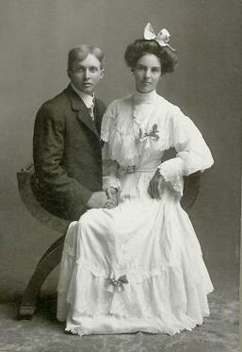
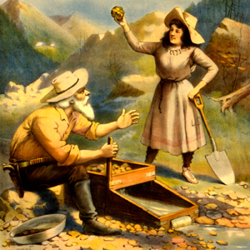
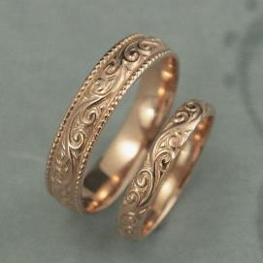
Marriage Between A Man And A Woman Is Ordained Of God
Mormon Pioneers were some of the first ‘49ers that found Gold in California. As young as 15-17 years old, some made their gold into wedding rings and Married their sweethearts.
Notes:
What did they call those Mormon Pioneers who found Gold in California? (Section 49)
At what age did some of them get married? (verses 15-17)

Slide 51
The Daily Dilemma
Some worldly thoughts on marriage
Marriage is not necessary.
Marriage was created by people.
Having children is a burden.
Marriage does not need to be between a man and a woman.
Marriage is for personal satisfaction or convenience.
If you get tired of your spouse, you should get divorced.
How does D&C 49:15-17 give a different point of view to those ideas?

Slide 52
Doctrinal Mastery Reference Quiz
____ Keys of the Aaronic Priesthood.
____ Look unto Christ in every thought.
____ The Holy Ghost speaks to our minds and hearts.
____ In the First Vision, God called Joseph Smith to be a prophet.
____ The only true and living church.
____ The voice of the Lord and His servants is the same.
JS-H 1:15-20
D&C 1:30
D&C 1:37-38
D&C 6:36
D&C 8:2-3
D&C 13:1

Slide 53
Doctrinal Mastery Reference Quiz
____ The Savior suffered for our sins so we could repent.
____ The worth of souls is great.
____ Christ will come again with power and glory.
____ As we receive the prophet’s word in patience and faith, God will dispense the powers of darkness.
____ The Lord’s representatives must be called by one who has authority.
____ Marriage between a man and a woman is ordained of God.
____ Joy in bringing souls to Jesus Christ.
D&C 18:10-11
D&C 18:15-16
D&C 19:16-19
D&C 21:4-6
D&C 29:10-11
D&C 42:11
D&C 49:15-17

