Slide 1
Doctrinal Mastery Passages
New Testament 2023 Fall Semester
Note: I included 1 Corinthians 6:19-20 here because it would be taught naturally in the Fall instead of the Spring for most teachers.
1st Term
1 Corinthians 6:19-20
1 Corinthians 11:11
1 Corinthians 15:20-22
1 Corinthians 15:40-42
Ephesians 1:10
Ephesians 2:19-20
2 Thessalonians 2:1-3
  Quiz 1st Term
2nd Term
2 Timothy 3:15-17
Hebrews 12:9
James 1:5-6
James 2:17-18
1 Peter 4:6
Revelation 20:12
  Quiz 2nd Term
New Testament Bookshelf
Mnemonic Handout
Slap-Jack

Slide 2
A Little Doctrinal Mastery Explanation
With Doctrinal Mastery, although memorization is not emphasized as it was, we are still to help our students know the passages, understand them, and help them be able to know the references to the passages. In the new curriculum they also emphasize memorizing the Scripture Phrases for the passages.
Each week you can spotlight a Doctrinal Mastery passage and help your students get to know that passage better. This can be done regardless of if you have taught there in the scriptures yet.
To spotlight a scripture for the week, it takes about 5 minutes each day. I have the class recite the verse in unison each day (first slide). Then do one of the following on different days:
  Ask the class why that verse is important and why it was chosen.
  Share the mnemonic (second slide). See helps to sharing a mnemonic on the next slide. Don’t forget to look at the PPT notes. Great helps there.
  Share a scenario and have them discuss or roleplay with their partner (third slide).
  Try to memorize the Doctrinal Mastery passage. (fourth slide)
  A quote to encourage your students in their personal scripture study goal.
I have broken the Doctrinal Mastery Verses into the 4 terms like your students might experience in the school year and a quiz for each term and semester. Since there is no longer grades in seminary, you can make incentives to help motivate them to learn the key words and references. It also helps for those stakes the have scripture bowls later in the year. I have also included a lot of other helps so look clear through this document. ☺

Slide 3
Core Credit Scriptures for the New Testament
Spring 2023
Fall 2023
Matthew 5-7 (7 pages)
Luke 2 (2 pages)
Luke 22:1-20 (.5 page)
John 10-21 (22 pages)
  Total: 31.5 pages
Acts 1-12 (22 pages)
Romans 8 (2 pages)
1 Corinthians 13 (1 page)
Hebrews 11 (2 pages)
2 Timothy 3 (1 page)
  Total: 28 pages

Slide 4
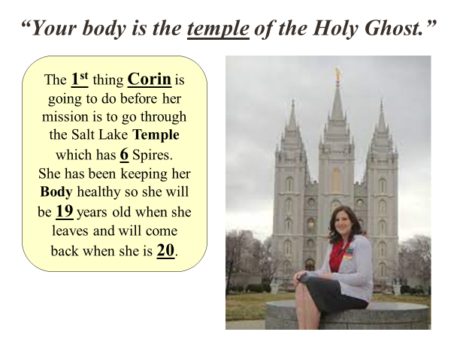
Steps To Learning Doctrinal Mastery Scriptures and Mnemonics
Keep the key words of the scripture in mind (especially the underlined words)
Use the notes in the PPT to help your students come up with the answers.
Link the key words to an idea or image in the cartoon mnemonic
Link the idea to the reference embedded in the cartoon mnemonic
Practice with a friend, with them saying the key words, and you giving the reference
Give hints from the mnemonic

Slide 5


Books of the New Testament
Matthew
Mark
Galatians
1 Corinthians
Philippians
2 Corinthians
Colossians
Acts
Romans
Ephesians
2 Thessalonians
1 Thessalonians
Luke
John
Gospels
Church History
Paul’s Letters to Churches
1 Peter
2 Peter
Philemon
1 John
2 Timothy
Titus
1 Timothy
Hebrews
James
Revelation
2 John
3 John
Jude
Paul’s Personal Letters
General Letters

Slide 6
Helps for learning the New Testament books
How many books in the New Testament? How many letters in New? (3) In Testament? (9). 3 * 9 = 27.
Sidenote, there are 39 books in the Old Testament.
What order are the books in?
  Chronological
  Alphabetical
  By Author
  By Size
  Answer: There are elements of A, C and D.
Color coded by author on the bookshelf.
How many books did John, Luke, and Paul write?
Sing the Primary song while looking at the bookshelf.

Slide 7
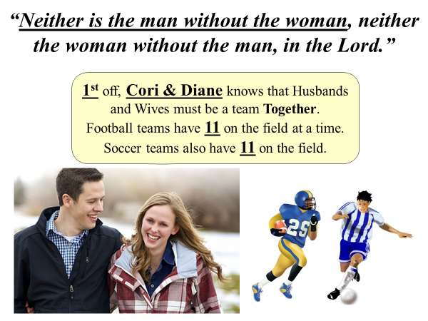
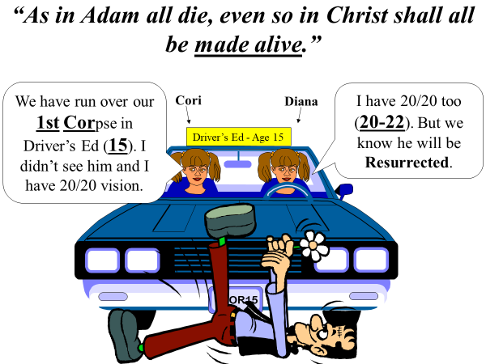
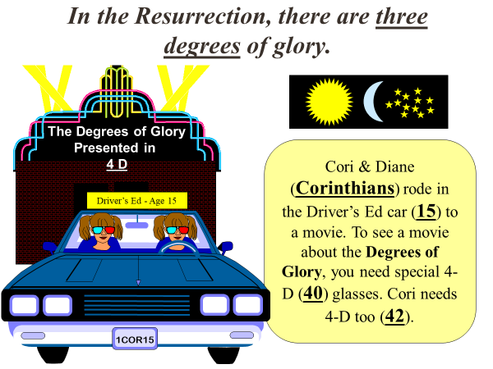
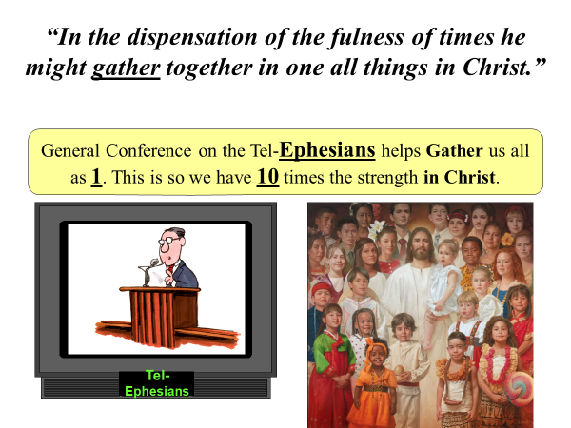
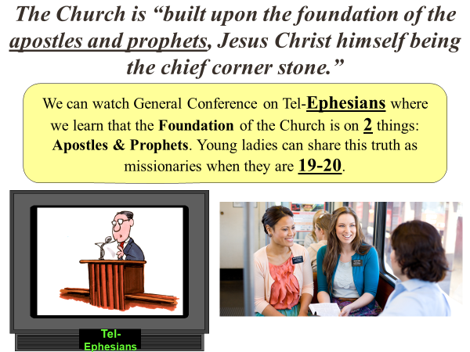
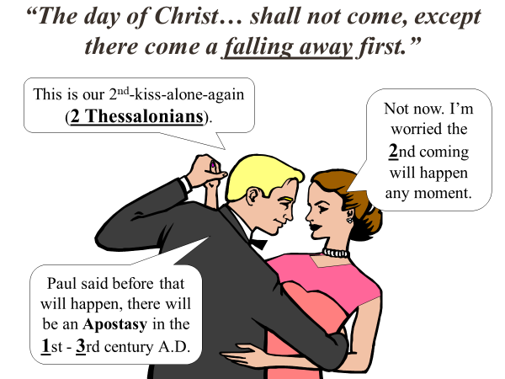
Some Possible Uses:
Print out a copy for each pair. Have one quiz the other by saying the Scripture Phrase and the other giving the reference. Encourage them to give hints instead of the answers.
Print and cut out the 6 squares and write the reference on each back. Then have the 6 cards laying out between the two students. Give a clue and the first person to touch the correct card with that reference, gets that card. Person with the most cards wins.

Slide 8
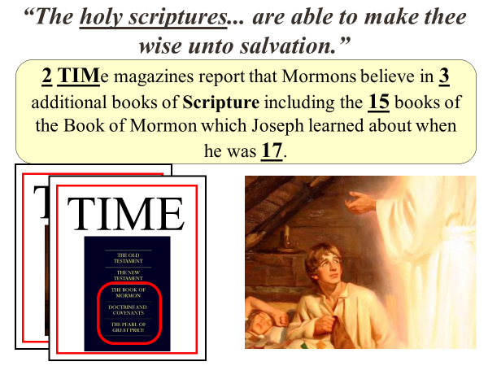
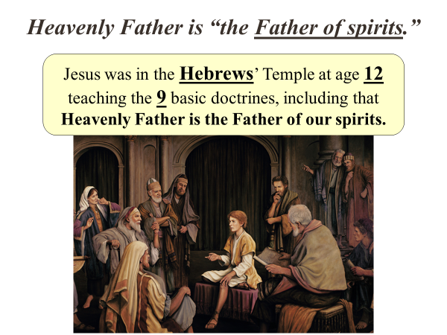
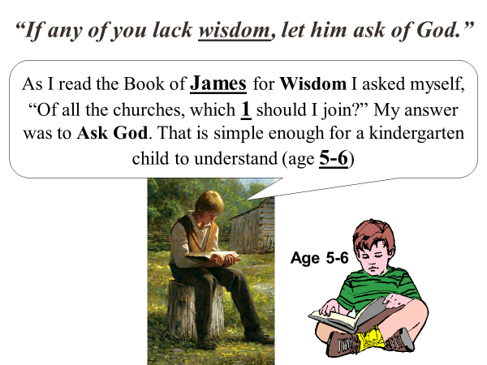
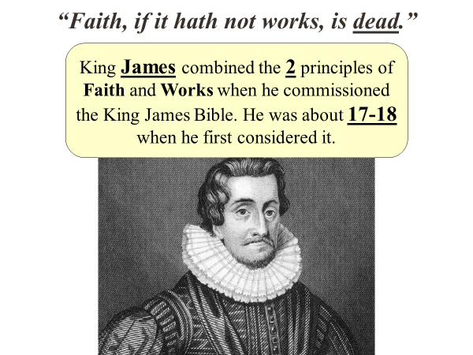
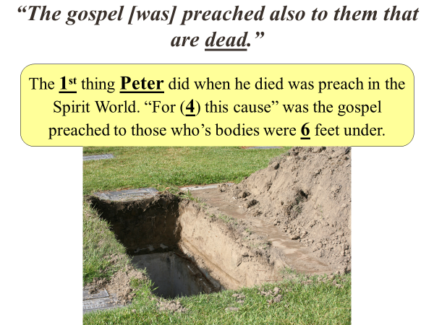
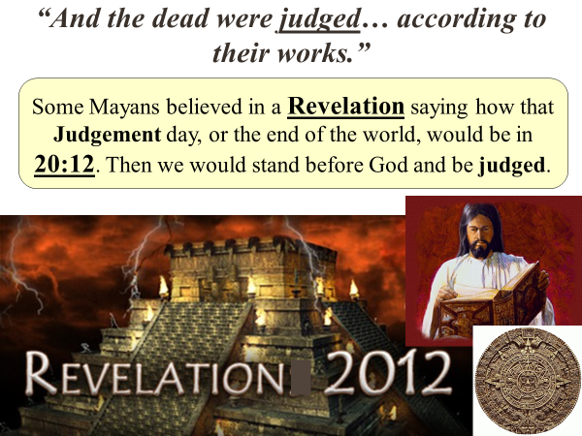
Some Possible Uses:
Print out a copy for each pair. Have one quiz the other by saying the Scripture Phrase and the other giving the reference. Encourage them to give hints instead of the answers.
Print and cut out the 6 squares and write the reference on each back. Then have the 6 cards laying out between the two students. Give a clue and the first person to touch the correct card with that reference, gets that card. Person with the most cards wins.

Slide 9
1 Corinthians 6:19-20
19 What? know ye not that your body is the temple of the Holy Ghost which is in you, which ye have of God, and ye are not your own?
20 For ye are bought with a price: therefore glorify God in your body, and in your spirit, which are God’s.
Notes:
After reciting the verse(s) together, ask why they chose this to be a Doctrinal Mastery?
“What is so important here that they decided this had to be included?”

Slide 10
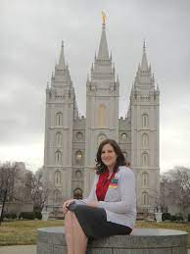
“Your body is the temple of the Holy Ghost.”
The 1st thing Corin is going to do before her mission is to go through the Salt Lake Temple which has 6 Spires.
She has been keeping her Body healthy so she will be 19 years old when she leaves and will come back when she is 20.
Notes:
Imagine you have a friend named Corin who is about to go on a mission.
What important event needs to happen before leaving? Temple
How many spires does the Salt Lake temple have? 6
If a young lady went right away, how old would she be when she left and returned? 19-20

Slide 11
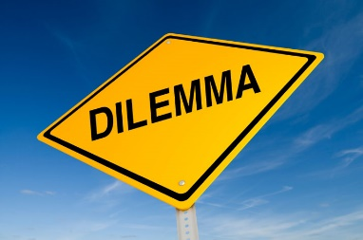

The Daily Dilemma
According to the verses, why are our bodies special?
Point out something in each verse that teaches that we need to try and keep our bodies healthy.
Point out anything that relates to the Law of Chastity.
With a partner, make up a scenario where sharing 1 Corinthians 6:19-20 would be very helpful. Share.
“What’s wrong with getting a tattoo or drinking alcohol? It’s my body!” Use the “For Strength of Youth” pamphlet to help your friend.

Slide 12

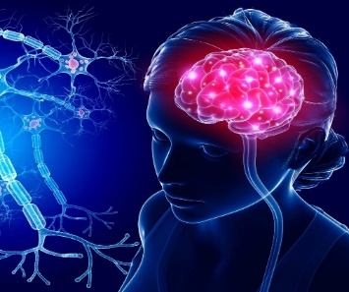
1 Corinthians 6:19-20
19 What? know ye not that your body is the temple of the Holy Ghost which is in you, which ye have of God, and ye are not your own?
20 For ye are bought with a price: therefore glorify God in your body, and in your spirit, which are God’s.

Slide 13
1 Corinthians 11:11
11 Nevertheless neither is the man without the woman, neither the woman without the man, in the Lord.
Notes:
After reciting the verse(s) together, ask why they chose this to be a Doctrinal Mastery?
“What is so important here that they decided this had to be included?”

Slide 14
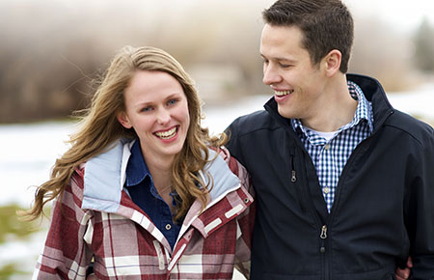
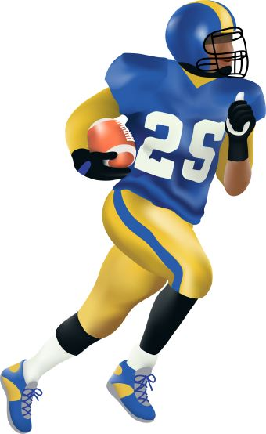
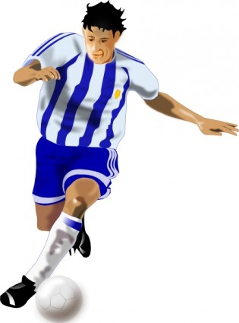
“Neither is the man without the woman, neither the woman without the man, in the Lord.”
1st off, Cori & Diane knows that Husbands and Wives must be a team Together. Football teams have 11 on the field at a time. Soccer teams also have 11 on the field.

Slide 15
The Daily Dilemma
Reid is concerned because he hears some of his fellow quorum members talking disrespectfully about women. How does the verse help?
How are mothers and fathers different in a home, but can help each other?
After watching a popular movie, a group of friends makes fun of the ridiculous actions of the father character. Several agree that the father wasn’t needed, and one friend states, “This is why you don’t need a man to raise a happy family.” Share the verse to help share God’s point of view.

Slide 16
1 Corinthians 11:11
11 Nevertheless neither is the man without the woman, neither the woman without the man, in the Lord.

Slide 17
1 Corinthians 15:20-22
20 But now is Christ risen from the dead, and become the firstfruits of them that slept.
21 For since by man came death, by man came also the resurrection of the dead.
22 For as in Adam all die, even so in Christ shall all be made alive.
Notes:
After reciting the verse(s) together, ask why they chose this to be a Doctrinal Mastery?
“What is so important here that they decided this had to be included?”

Slide 18
“As in Adam all die, even so in Christ shall all be made alive.”
We have run over our 1st Corpse in Driver’s Ed (15). I didn’t see him and I have 20/20 vision.
Cori
I have 20/20 too (20-22). But we know he will be Resurrected.
Diana
Driver’s Ed - Age 15
1COR15
Notes:
I C “THE RESURRECTION” has 15 letters.

Slide 19
The Daily Dilemma
What does it mean for a person to be resurrected?
How many people will be resurrected?
Who was the first person to be resurrected?
How does the knowledge of the resurrection give hope to someone hurting from the loss of a loved one?

Slide 20
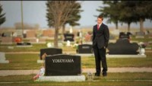
“He will give you hope” https://www.youtube.com/watch?v=VDbMAeMdpB0

Slide 21
1 Corinthians 15:20-22
20 But now is Christ risen from the dead, and become the firstfruits of them that slept.
21 For since by man came death, by man came also the resurrection of the dead.
22 For as in Adam all die, even so in Christ shall all be made alive.

Slide 22
1 Corinthians 15:40-42
40 There are also celestial bodies, and bodies terrestrial: but the glory of the celestial is one, and the glory of the terrestrial is another.
41 There is one glory of the sun, and another glory of the moon, and another glory of the stars: for one star differeth from another star in glory.
42 So also is the resurrection of the dead. It is sown in corruption; it is raised in incorruption:
Notes:
After reciting the verse(s) together, ask why they chose this to be a Doctrinal Mastery?
“What is so important here that they decided this had to be included?”

Slide 23
In the Resurrection, there are three degrees of glory.
The Degrees of Glory
Presented in
4 D
Cori & Diane (Corinthians) rode in the Driver’s Ed car (15) to a movie. To see a movie about the Degrees of Glory, you need special 4-D (40) glasses. Cori needs 4-D too (42).
Driver’s Ed - Age 15
1COR15
Notes:
I C “THE RESURRECTION” has 15 letters.

Slide 24
The Daily Dilemma
A friend says, “It is hard for me to believe in heaven and hell because there are more than just two types of people –good and bad.”
Julia sincerely tries to do what’s right, but she often feels condemned because of her weaknesses. She believes that other people will go to the celestial kingdom but doubts that she will make it.
Maria just heard a great talk about the gift of resurrection that Heavenly Father and Jesus Christ will give to everyone. She wonders, “Why should I repent or keep the commandments if everyone is going to be resurrected in a perfect immortal body anyway?”

Slide 25
1 Corinthians 15:40-42
40 There are also celestial bodies, and bodies terrestrial: but the glory of the celestial is one, and the glory of the terrestrial is another.
41 There is one glory of the sun, and another glory of the moon, and another glory of the stars: for one star differeth from another star in glory.
42 So also is the resurrection of the dead. It is sown in corruption; it is raised in incorruption:

Slide 26
Ephesians 1:10
10 That in the dispensation of the fulness of times he might gather together in one all things in Christ, both which are in heaven, and which are on earth; even in him:
Notes:
After reciting the verse(s) together, ask why they chose this to be a Doctrinal Mastery?
“What is so important here that they decided this had to be included?”

Slide 27
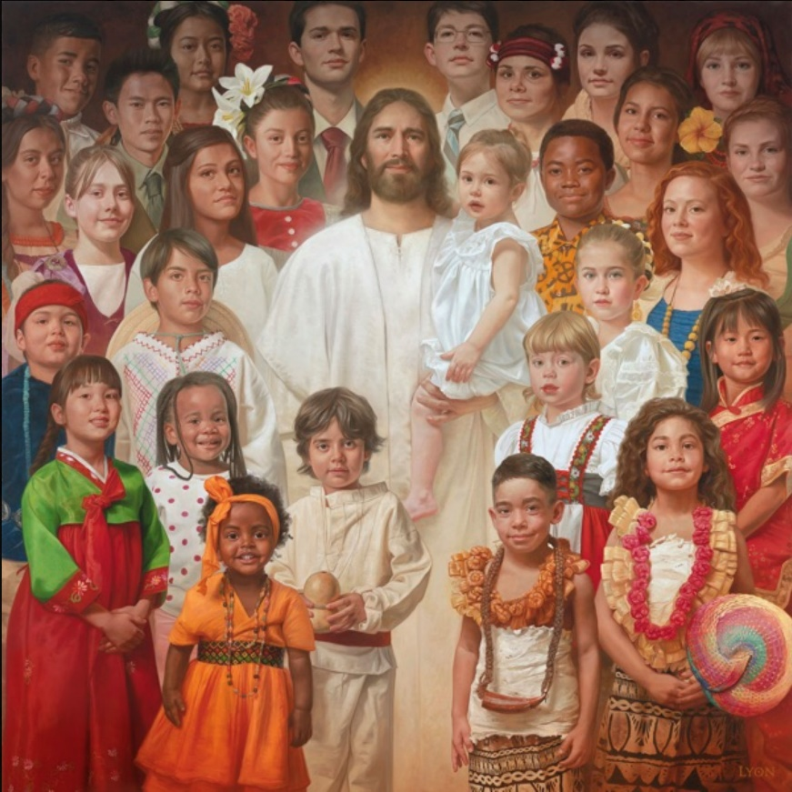
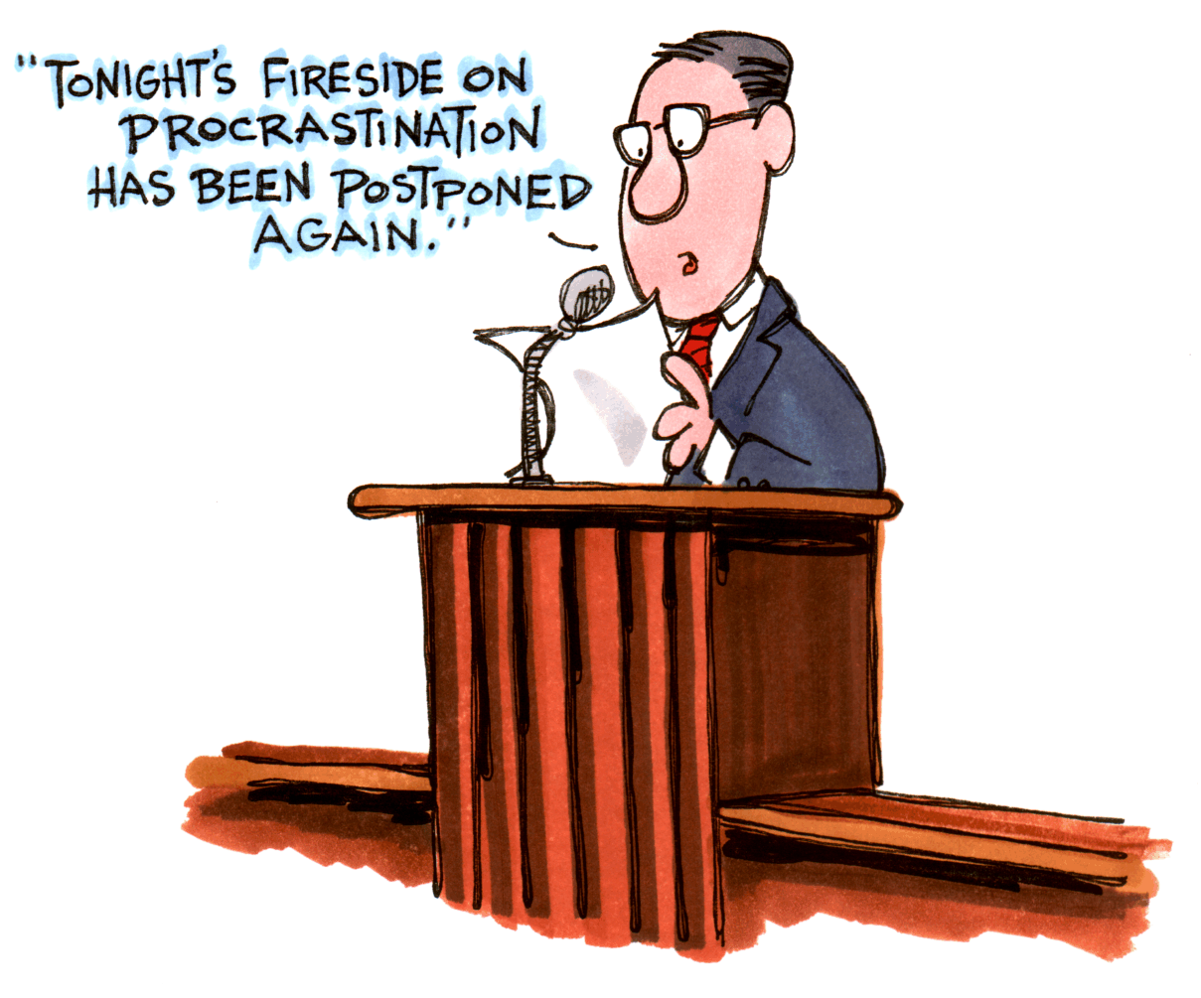
“In the dispensation of the fulness of times he might gather together in one all things in Christ.”
General Conference on the Tel-Ephesians helps Gather us all as 1. This is so we have 10 times the strength in Christ.
Tel- Ephesians
Notes:
Where do most people watch General Conference? On the Tel-Ephesian.

Slide 28
The Daily Dilemma
During the dispensation of the fulness of times, all things from former dispensations will be restored. What does this mean?
Are their any teachings in the Bible about the Latter-day Restoration of the gospel?
How should we gather Israel? What will make people want to become part of God’s kingdom?

Slide 29
Ephesians 1:10
10 That in the dispensation of the fulness of times he might gather together in one all things in Christ, both which are in heaven, and which are on earth; even in him:

Slide 30
Ephesians 2:19-20
19 Now therefore ye are no more strangers and foreigners, but fellowcitizens with the saints, and of the household of God;
20 And are built upon the foundation of the apostles and prophets, Jesus Christ himself being the chief corner stone;
Notes:
After reciting the verse(s) together, ask why they chose this to be a Doctrinal Mastery?
“What is so important here that they decided this had to be included?”

Slide 31
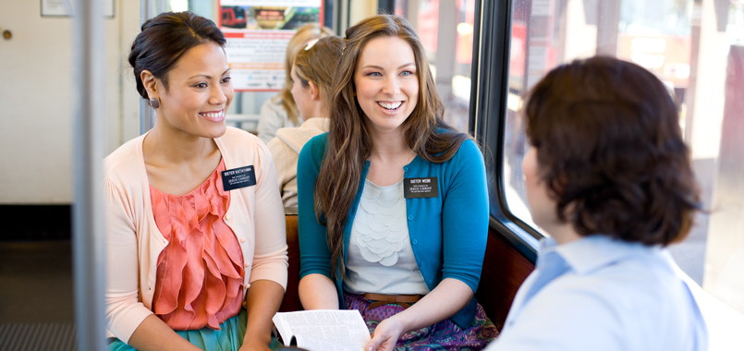
The Church is “built upon the foundation of the apostles and prophets, Jesus Christ himself being the chief corner stone.”
We can watch General Conference on Tel-Ephesians where we learn that the Foundation of the Church is on 2 things: Apostles & Prophets. Young ladies can share this truth as missionaries when they are 19-20.
Tel- Ephesians

Slide 32
The Daily Dilemma
How is the Church organized?
A young man moved into your ward and you can tell he doesn’t feel very comfortable in your quorum.
“Why does your church have prophets and apostles?” “What do the scriptures teach about prophets and apostles?” or “What is the relationship between the Savior and prophets and apostles?”
Imagine that your close friend Estelle and her family still believe Jesus Christ and the Bible but are thinking about leaving the Church because they do not agree with some things that the prophet and apostles are currently teaching. She asks you for help to know what to do.

Slide 33
Ephesians 2:19-20
19 Now therefore ye are no more strangers and foreigners, but fellowcitizens with the saints, and of the household of God;
20 And are built upon the foundation of the apostles and prophets, Jesus Christ himself being the chief corner stone;

Slide 34
2 Thessalonians 2:1-3
1 Now we beseech you, brethren, by the coming of our Lord Jesus Christ, and by our gathering together unto him,
2 That ye be not soon shaken in mind, or be troubled, neither by spirit, nor by word, nor by letter as from us, as that the day of Christ is at hand.
3 Let no man deceive you by any means: for that day shall not come, except there come a falling away first, and that man of sin be revealed, the son of perdition;
Notes:
After reciting the verse(s) together, ask why they chose this to be a Doctrinal Mastery?
“What is so important here that they decided this had to be included?”

Slide 35
“The day of Christ… shall not come, except there come a falling away first.”
This is our 2nd-kiss-alone-again (2 Thessalonians).
Not now. I’m worried the 2nd coming will happen any moment.
Paul said before that will happen, there will be an Apostasy in the 1st - 3rd century A.D.

Slide 36
The Daily Dilemma
Why was the Restoration of Jesus Christ’s Church necessary?
“Why did God need to appear to Joseph Smith to restore His Church if Christianity was already established and many people already believed in the Bible?”
If the Lord established His Church when He was on the earth, what happened to it?
What is “The Great Apostasy”?
Imagine you are texting your friend Keyshawn, who is a member of a different Christian church. He is very devoted to Jesus Christ and studies the Bible frequently. In a text message to you, Keyshawn said, “Today my pastor taught that members of your church believe that yours is the only true church and every other church is false. Is that true? I feel closer to God because of my church. How could it not be from God?”

Slide 37
2 Thessalonians 2:1-3
1 Now we beseech you, brethren, by the coming of our Lord Jesus Christ, and by our gathering together unto him,
2 That ye be not soon shaken in mind, or be troubled, neither by spirit, nor by word, nor by letter as from us, as that the day of Christ is at hand.
3 Let no man deceive you by any means: for that day shall not come, except there come a falling away first, and that man of sin be revealed, the son of perdition;

Slide 38
Doctrinal Mastery Quiz
____ “In the dispensation of the fulness of times he might gather together in one all things in Christ.”
____ “The day of Christ… shall not come, except there come a falling away first.”
____ “As in Adam all die, even so in Christ shall all be made alive.”
____ “Your body is the temple of the Holy Ghost.”
____ In the Resurrection, there are three degrees of glory.
____ The Church is “built upon the foundation of the apostles and prophets, Jesus Christ himself being the chief corner stone.”
____ “Neither is the man without the woman, neither the woman without the man, in the Lord.”
1 Corinthians 6:19-20
1 Corinthians 11:11
1 Corinthians 15:20-22
1 Corinthians 15:40-42
Ephesians 1:10
Ephesians 2:19-20
2 Thessalonians 2:1-3

Slide 39
2 Timothy 3:15-17
15 And that from a child thou hast known the holy scriptures, which are able to make thee wise unto salvation through faith which is in Christ Jesus.
16 All scripture is given by inspiration of God, and is profitable for doctrine, for reproof, for correction, for instruction in righteousness:
17 That the man of God may be perfect, throughly furnished unto all good works.
Notes:
After reciting the verse(s) together, ask why they chose this to be a Doctrinal Mastery?
“What is so important here that they decided this had to be included?”

Slide 40
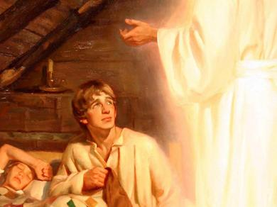
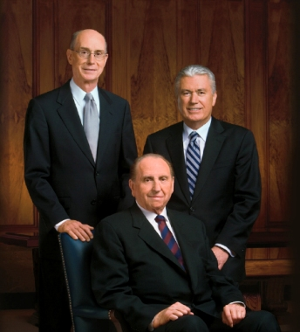
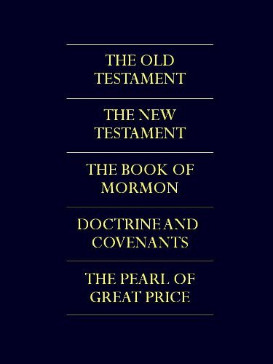
“The holy scriptures... are able to make thee wise unto salvation.”
2 TIMe magazines report that Mormons believe in 3 additional books of Scripture including the 15 books of the Book of Mormon which Joseph learned about when he was 17.
TIME
TIME
Notes:
How many additional books of scriptures do we have? 3
How many books in the Book of Mormon? 15

Slide 41
The Daily Dilemma
A friend of yours does not really see a need to study the scriptures daily. He says, “There are a lot of important things in my life right now. I don’t really have time to study my scriptures.”
Imagine you are a missionary teaching a young woman named Suravi. Suravi has been receptive to the message of the Restoration but has been hesitant to read scripture passages you and your companion have suggested. During a visit, you ask Suravi what has been keeping her from reading the scriptures. She replies that she doesn’t enjoy reading the scriptures and finds them boring.
Using 2 Timothy 3:15–17, give a response explaining the blessings and benefits of scripture study in a way that might motivate Suravi. If possible, consider adding personal experiences and testimony as part of your response.

Slide 42
Feasting on the word of God each day is more important than sleep, school, work, television shows, video games, or social media. You may need to reorganize your priorities to provide time for the study of the word of God. If so, do it!
(Richard G. Scott, “Make the Exercise of Faith Your First Priority,” Ensign or Liahona, Nov. 2014, 93)

Slide 43
2 Timothy 3:15-17
15 And that from a child thou hast known the holy scriptures, which are able to make thee wise unto salvation through faith which is in Christ Jesus.
16 All scripture is given by inspiration of God, and is profitable for doctrine, for reproof, for correction, for instruction in righteousness:
17 That the man of God may be perfect, throughly furnished unto all good works.

Slide 44
Hebrews 12:9
9 Furthermore we have had fathers of our flesh which corrected us, and we gave them reverence: shall we not much rather be in subjection unto the Father of spirits, and live?
Notes:
After reciting the verse(s) together, ask why they chose this to be a Doctrinal Mastery?
“What is so important here that they decided this had to be included?”

Slide 45
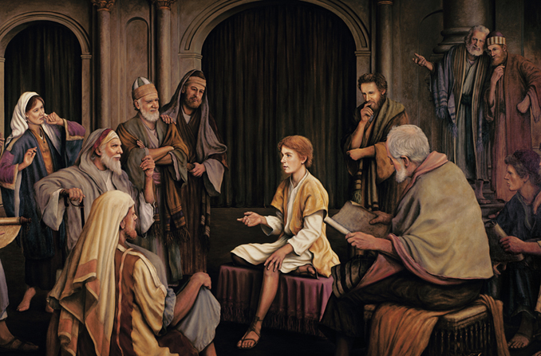
Heavenly Father is “the Father of spirits.”
Jesus was in the Hebrews’ Temple at age 12 teaching the 9 basic doctrines, including that Heavenly Father is the Father of our spirits.

Slide 46
The Daily Dilemma
What are ways people identify themselves?
What are our most important identities?
What are the most important ways we should identify ourselves?
Imagine that you are speaking with a friend who is questioning who they are. Use Hebrews 12:9 to help them. As you answer their questions or address their concerns, consider including the following:
What it means that we are children of God and why it matters to know this
Ways the world tries to influence our knowledge about who we are and our relationship to God, and why we would want to resist these influences
What is our relationship to God?

Slide 47
Hebrews 12:9
9 Furthermore we have had fathers of our flesh which corrected us, and we gave them reverence: shall we not much rather be in subjection unto the Father of spirits, and live?

Slide 48
James 1:5-6
5 If any of you lack wisdom, let him ask of God, that giveth to all men liberally, and upbraideth not; and it shall be given him.
6 But let him ask in faith, nothing wavering. For he that wavereth is like a wave of the sea driven with the wind and tossed.
Notes:
After reciting the verse(s) together, ask why they chose this to be a Doctrinal Mastery?
“What is so important here that they decided this had to be included?”

Slide 49
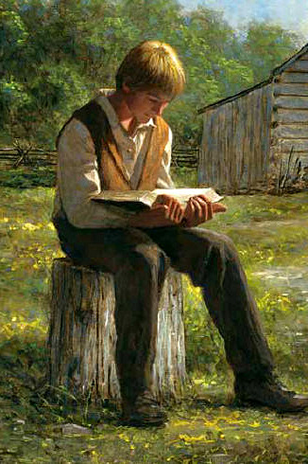
“If any of you lack wisdom, let him ask of God.”
As I read the Book of James for Wisdom I asked myself, “Of all the churches, which 1 should I join?” My answer was to Ask God. That is simple enough for a kindergarten child to understand (age 5-6)
Age 5-6

Slide 50
The Daily Dilemma
Your Christian friend says, “There are so many different opinions about what is true. How can anyone know what is right?” Help them by explaining James 1:5-6 to them.
Explain how James 1:5-6 effected Joseph Smith’s life. Could you explain his story with this verse?
Besides prayer, what else did Joseph Smith do to find answers?
What are big questions you, or people your age, face?

Slide 51
James 1:5-6
5 If any of you lack wisdom, let him ask of God, that giveth to all men liberally, and upbraideth not; and it shall be given him.
6 But let him ask in faith, nothing wavering. For he that wavereth is like a wave of the sea driven with the wind and tossed.

Slide 52
James 2:17-18
17 Even so faith, if it hath not works, is dead, being alone.
18 Yea, a man may say, Thou hast faith, and I have works: shew me thy faith without thy works, and I will shew thee my faith by my works.
Notes:
After reciting the verse(s) together, ask why they chose this to be a Doctrinal Mastery?
“What is so important here that they decided this had to be included?”

Slide 53
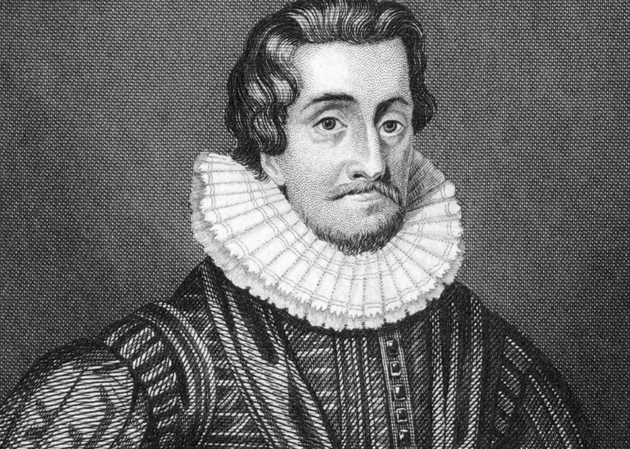
“Faith, if it hath not works, is dead.”
King James combined the 2 principles of Faith and Works when he commissioned the King James Bible. He was about 17-18 when he first considered it.
Notes:
Graduating from Seminary (17) and going on a mission (18) shows our faith and works.

Slide 54
The Daily Dilemma
More than passive belief, true faith in Jesus Christ leads to action and is expressed by the way we live.
Your friend asks, “Why does it mater what I do? I believe in Jesus Christ. Isn’t that enough?” Help explain the relationship of true faith in Christ, to our works using James 2:17-18.
A friend asks you why your church requires so much of you.

Slide 55
James 2:17-18
17 Even so faith, if it hath not works, is dead, being alone.
18 Yea, a man may say, Thou hast faith, and I have works: shew me thy faith without thy works, and I will shew thee my faith by my works.

Slide 56
1 Peter 4:6
6 For for this cause was the gospel preached also to them that are dead, that they might be judged according to men in the flesh, but live according to God in the spirit.
Notes:
After reciting the verse(s) together, ask why they chose this to be a Doctrinal Mastery?
“What is so important here that they decided this had to be included?”

Slide 57
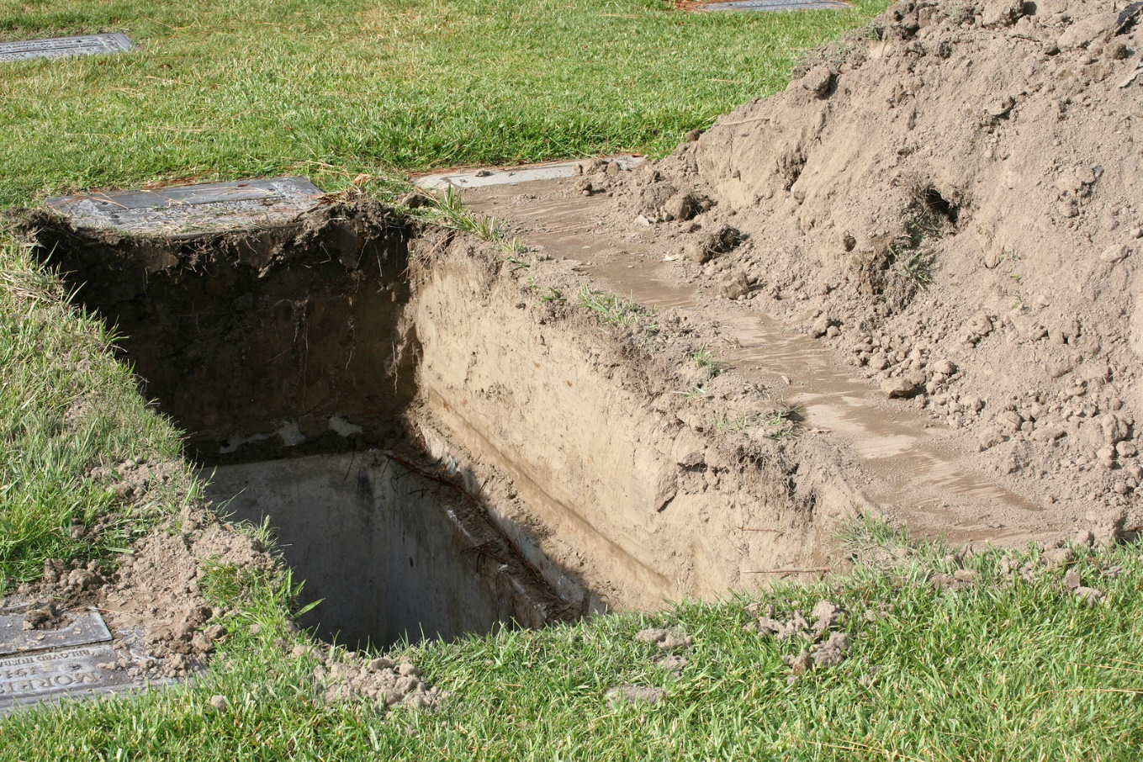
“The gospel [was] preached also to them that are dead.”
The 1st thing Peter did when he died was preach in the Spirit World. “For (4) this cause” was the gospel preached to those who’s bodies were 6 feet under.
Notes:
Many religions believe that when you die, you go to Peter who is at the Pearly gates of Heaven.

Slide 58
The Daily Dilemma
As a missionary, you are asked, “What happens to the billions who never have had the chance to learn of Jesus Christ or be baptized in this life?” Use 1 Peter 4:6 to help answer their question.
Your friend says, “My grandpa just passed away. He was a really good person, but he wasn’t religious at all. What is going to happen to him?” Use a Doctrinal Mastery to help your friend.

Slide 59
1 Peter 4:6
6 For for this cause was the gospel preached also to them that are dead, that they might be judged according to men in the flesh, but live according to God in the spirit.

Slide 60
Revelation 20:12
12 And I saw the dead, small and great, stand before God; and the books were opened: and another book was opened, which is the book of life: and the dead were judged out of those things which were written in the books, according to their works.
Notes:
After reciting the verse(s) together, ask why they chose this to be a Doctrinal Mastery?
“What is so important here that they decided this had to be included?”

Slide 61
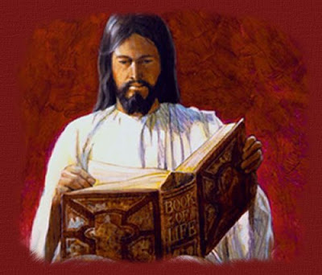
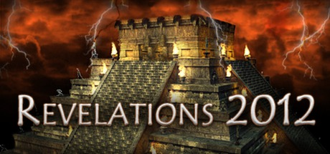
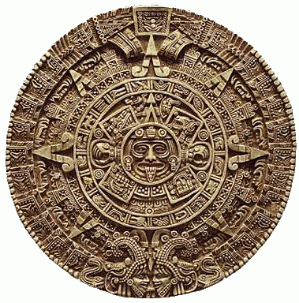
“And the dead were judged… according to their works.”
Some Mayans believed in a Revelation saying how that Judgement day, or the end of the world, would be in 20:12. Then we would stand before God and be judged.

Slide 62
The Daily Dilemma
How will I be judged in the end?
Stephanie has some friends who live a worldly lifestyle. She admits that although they are breaking the commandments, what they are doing looks fun at times. She has not noticed major negative consequences for their choices and is considering joining them.
Kayla is a righteous young woman who humbly repents when she makes mistakes, but she still feels scared when people talk about the Final Judgment. She tries not to think about it.

Slide 63
Revelation 20:12
12 And I saw the dead, small and great, stand before God; and the books were opened: and another book was opened, which is the book of life: and the dead were judged out of those things which were written in the books, according to their works.

Slide 64
Doctrinal Mastery Quiz
____ “If any of you lack wisdom, let him ask of God.”
____ “And the dead were judged… according to their works.”
____ “Faith, if it hath not works, is dead.”
____ “The holy scriptures... are able to make thee wise unto salvation.”
____ “The gospel [was] preached also to them that are dead.”
____ Heavenly Father is “the Father of spirits.”
2 Timothy 3:15-17
Hebrews 12:9
James 1:5-6
James 2:17-18
1 Peter 4:6
Revelation 20:12

Slide 65

Slap-Jack
Before you can have effective scripture chasing, they first need to learn the references to the key words or clues. This game sharpens that skill. It will also help you see who is your fastest. There are many versions of this game. How I do it is I set a long row of tables and seat students on each side facing each other. How many depends on how many students you have. All student’s things (including scriptures) need to be put away far from the tables. They may use their bookmarks if they still need it.
One end is the top positions and the other is the bottom positions. There can be no seats not filled and only an even number of students can play at once. One paper (see handouts) is placed between each pair facing each other. Some key words are said by you and the first in the pair to touch that square with their index finger, wins. Do best of 3. Then the winner of the best of 3 goes ONE seat up (towards the top position) and the loser goes down ONE seat towards the bottom position. After each best of three, each student will have to move down or up. No one can remain sitting in the same place unless they won in the very top position or lost in the very bottom position. They may have to switch to the other side of the table if the chair next to them is filled. The first time can be confusing but once you have done it a couple of times, it’s easy.
The number or chairs and tables will naturally depend on the size of your class. You can also do it chasing in their scriptures instead of slapping the reference on the paper.
Top 2 Positions
Bottom 2 Positions

Slide 66
1 Corinthians 11:11
Ephesians 1:10
1 Corinthians 15:20-22
1 Corinthians 11:11
Ephesians 1:10
1 Corinthians 15:20-22
Ephesians 2:19-20
1 Corinthians 15:40-42
2 Thessalonians 2:1-3
Ephesians 2:19-20
1 Corinthians 15:40-42
2 Thessalonians 2:1-3

Slide 67
“In the dispensation of the fulness of times he might gather together in one all things in Christ.”
“Neither is the man without the woman, neither the woman without the man, in the Lord.”
“As in Adam all die, even so in Christ shall all be made alive.”
“As in Adam all die, even so in Christ shall all be made alive.”
“In the dispensation of the fulness of times he might gather together in one all things in Christ.”
“Neither is the man without the woman, neither the woman without the man, in the Lord.”
“The day of Christ… shall not come, except there come a falling away first.”
The Church is “built upon the foundation of the apostles and prophets, Jesus Christ himself being the chief corner stone.”
In the Resurrection, there are three degrees of glory.
“The day of Christ… shall not come, except there come a falling away first.”
In the Resurrection, there are three degrees of glory.
The Church is “built upon the foundation of the apostles and prophets, Jesus Christ himself being the chief corner stone.”

Slide 68
1 Peter 4:6
James 1:5-6
2 Timothy 3:15-17
1 Peter 4:6
James 1:5-6
2 Timothy 3:15-17
Revelation 20:12
Hebrews 12:9
James 2:17-18
Revelation 20:12
Hebrews 12:9
James 2:17-18

Slide 69
“The holy scriptures... are able to make thee wise unto salvation.”
“If any of you lack wisdom, let him ask of God.”
“The gospel [was] preached also to them that are dead.”
“The holy scriptures... are able to make thee wise unto salvation.”
“If any of you lack wisdom, let him ask of God.”
“The gospel [was] preached also to them that are dead.”
“And the dead were judged… according to their works.”
“Faith, if it hath not works, is dead.”
Heavenly Father is “the Father of spirits.”
“Faith, if it hath not works, is dead.”
Heavenly Father is “the Father of spirits.”
“And the dead were judged… according to their works.”

