Slide 1
Doctrinal Mastery Passages
New Testament 2023 Spring Semester
Note: Because we are asked to teach the Doctrinal Mastery lessons as we come to each Doctrinal Mastery while teaching, I put them here in terms of teaching chronology, rather than sequential by book.
1st Term
Luke 2:10-12
John 3:5
John 3:16
Matthew 5:14-16
Matthew 11:28-30
Matthew 16:15-19
  Quiz 1st Term
2nd Term
John 7:17
Matthew 22:36-39
John 17:3
Luke 22:19-20
Luke 24:36-39
1 Corinthians 6:19-20
  Quiz 2nd Term
Mnemonic Handout
New Testament Bookshelf

Slide 2
A Little Explanation
With Doctrinal Mastery, although memorization is not emphasized as it was, we are still to help our students know the passages, understand them, and help them be able to know the references to the passages. In the new curriculum they also emphasize memorizing the Scripture Phrases for the passages.
Each week you can spotlight a Doctrinal Mastery passage and help your students get to know that passage better. This can be done regardless of if you have taught there in the scriptures yet.
To spotlight a scripture for the week, it takes about 5 minutes each day. I have the class recite the verse in unison each day (first slide). Then do one of the following on different days:
  Ask the class why that verse is important and why it was chosen.
  Share the mnemonic (second slide). See helps to sharing a mnemonic on the next slide. Don’t forget to look at the PPT notes. Great helps there.
  Try to memorize the Scripture Phrase for the Doctrinal Mastery passage. (third slide)
  Share a scenario and have them discuss or roleplay with their partner (fourth slide).
I have broken the Doctrinal Mastery Verses into the 4 terms like your students might experience in the school year and a quiz for each term and semester. Since there is no longer grades in seminary, you can make incentives to help motivate them to learn the key words and references. It also helps for those stakes the have scripture bowls later in the year.

Slide 3
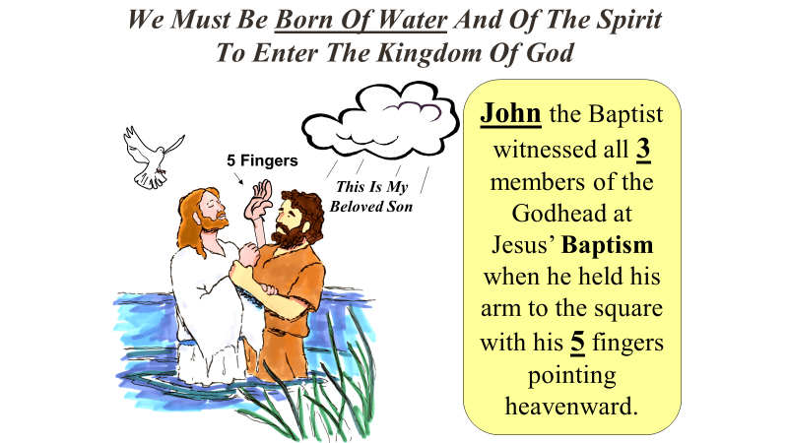
Steps To Learning Doctrinal Mastery Scriptures and Mnemonics
Keep the key words of the scripture in mind (especially the underlined words)
Use the notes in the PPT to help your students come up with the answers.
Link the key words to an idea or image in the cartoon mnemonic
Link the idea to the reference embedded in the cartoon mnemonic
Practice with a friend, with them saying the key words, and you giving the reference
Give hints from the mnemonic

Slide 4


Books of the New Testament
Matthew
Mark
Galatians
1 Corinthians
Philippians
2 Corinthians
Colossians
Acts
Romans
Ephesians
2 Thessalonians
1 Thessalonians
Luke
John
Gospels
Church History
Paul’s Letters to Churches
1 Peter
2 Peter
Philemon
1 John
2 Timothy
Titus
1 Timothy
Hebrews
James
Revelation
2 John
3 John
Jude
Paul’s Personal Letters
General Letters

Slide 5
Helps for learning the New Testament books
How many books in the New Testament? How many letters in New? (3) In Testament? (9). 3 * 9 = 27.
Sidenote, there are 39 books in the Old Testament.
What order are the books in?
  Chronological
  Alphabetical
  By Author
  By Size
  Answer: There are elements of A, C and D.
Color coded by author on the bookshelf.
How many books did John, Luke, and Paul write?
Sing the Primary song while looking at the bookshelf.

Slide 6
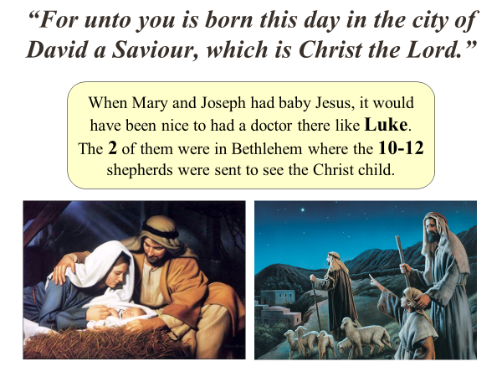
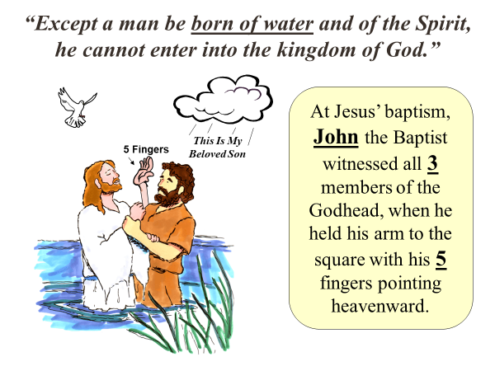
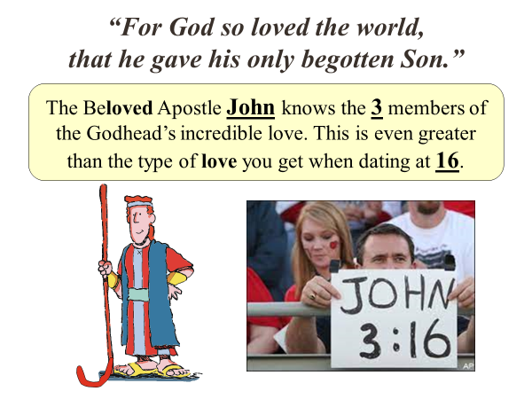
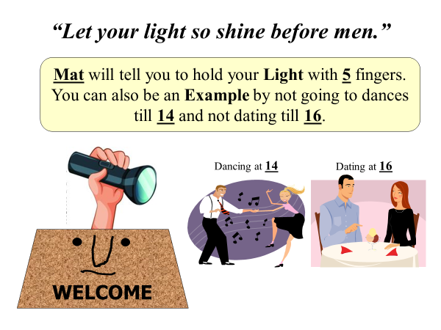
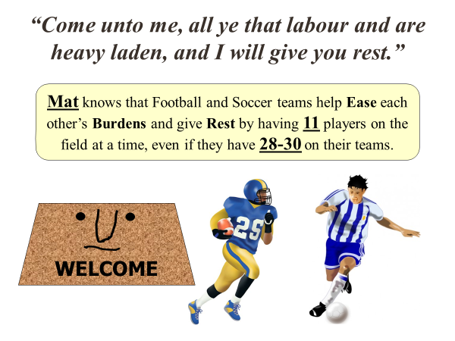
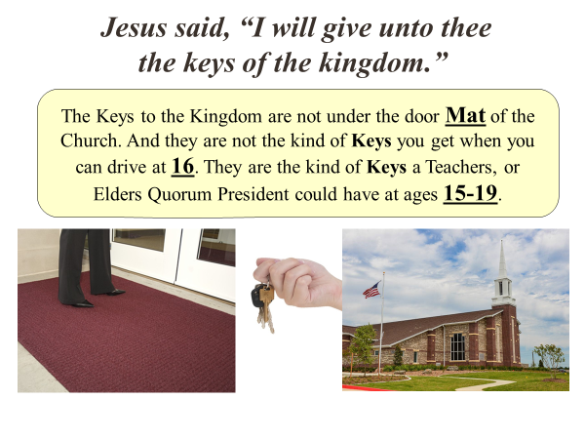
Some Possible Uses:
Print out a copy for each pair. Have one quiz the other by saying the Scripture Phrase and the other giving the reference. Encourage them to give hints instead of the answers.
Print and cut out the 6 squares and write the reference on each back. Then have the 6 cards laying out between the two students. Give a clue and the first person to touch the correct card with that reference, gets that card. Person with the most cards wins.

Slide 7
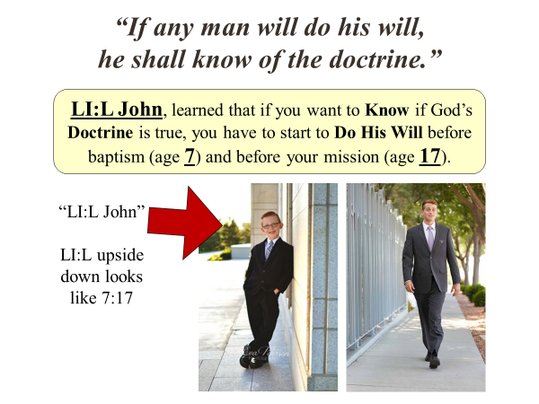
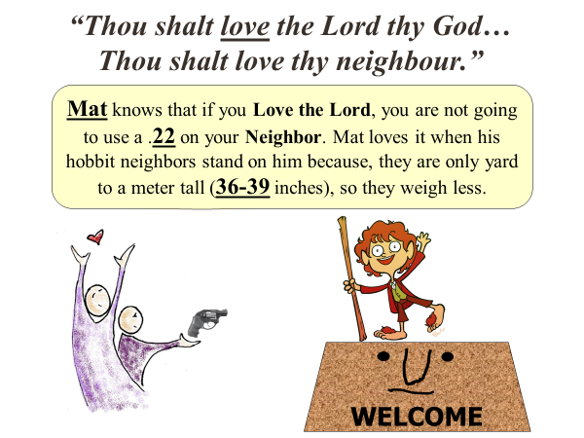
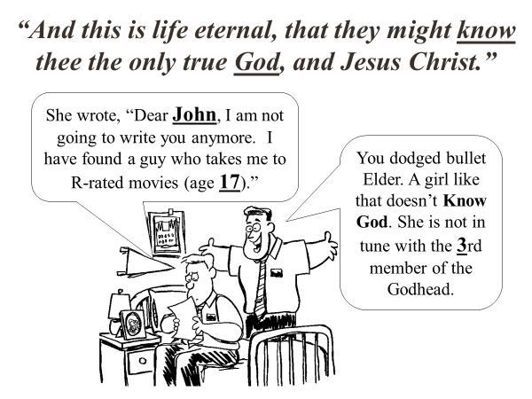
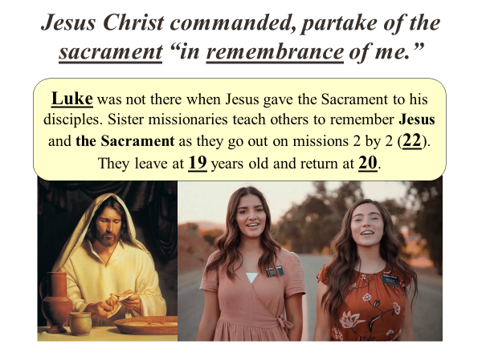
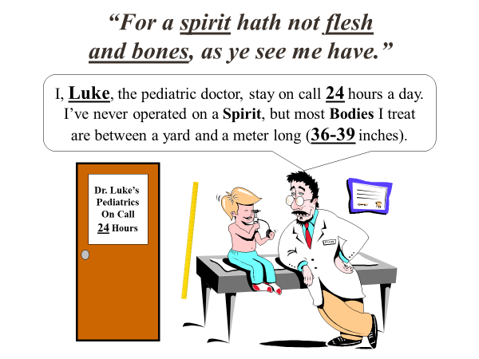
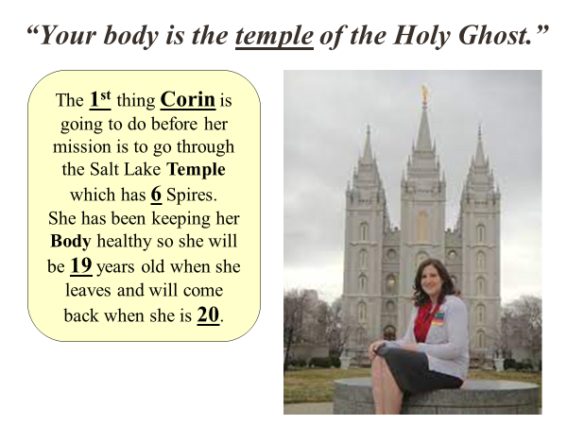
Some Possible Uses:
Print out a copy for each pair. Have one quiz the other by saying the Scripture Phrase and the other giving the reference. Encourage them to give hints instead of the answers.
Print and cut out the 6 squares and write the reference on each back. Then have the 6 cards laying out between the two students. Give a clue and the first person to touch the correct card with that reference, gets that card. Person with the most cards wins.

Slide 8
Luke 2:10-12
10 And the angel said unto them, Fear not: for, behold, I bring you good tidings of great joy, which shall be to all people.
11 For unto you is born this day in the city of David a Saviour, which is Christ the Lord.
12 And this shall be a sign unto you; Ye shall find the babe wrapped in swaddling clothes, lying in a manger.

Slide 9
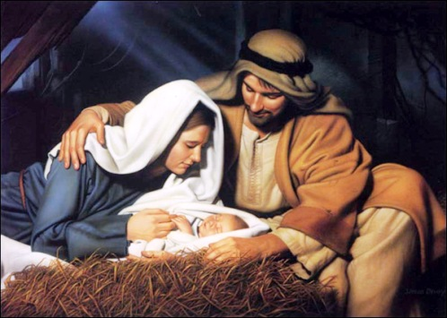
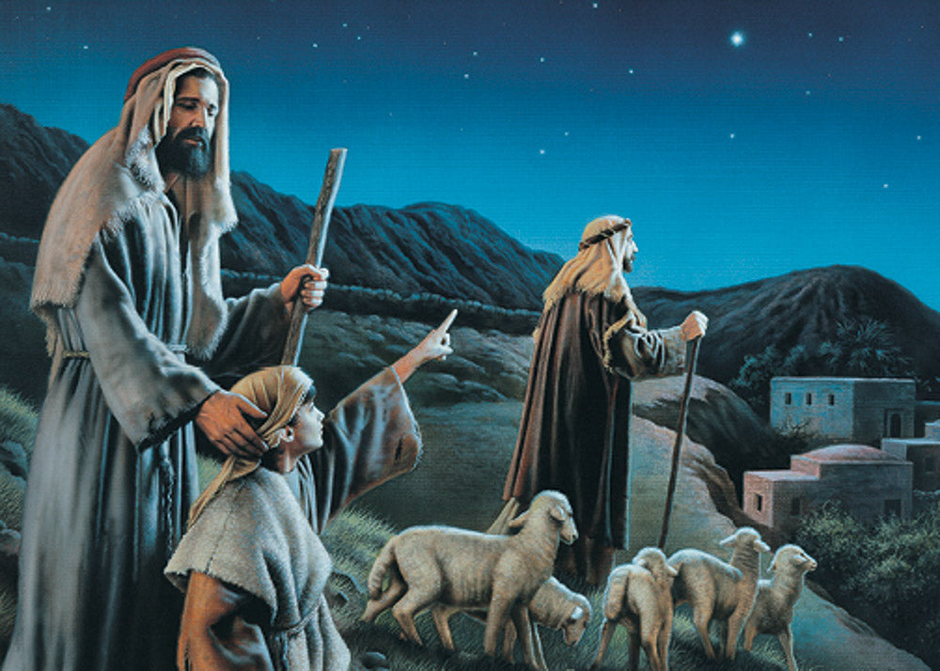
“For unto you is born this day in the city of David a Saviour, which is Christ the Lord.”
When Mary and Joseph had baby Jesus, it would have been nice to had a doctor there like Luke.
The 2 of them were in Bethlehem where the 10-12 shepherds were sent to see the Christ child.
Notes:
The greatest birth every celebrated was the Saviors Birth.
Was there a doctor there? Would have been nice to have Luke there.
Mary and Joseph (2 of them) were in Bethlehem.
10-12 shepherds came. How do we know 10? Because shepherd “Ten-d” sheep.

Slide 10

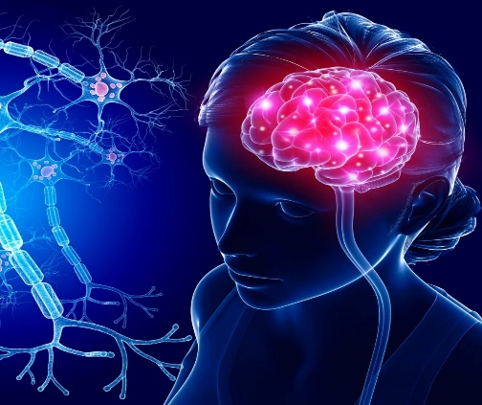
Memorizing
F u y i b t d i t c o D a S, w i C t L. -L _:_-_

Slide 11
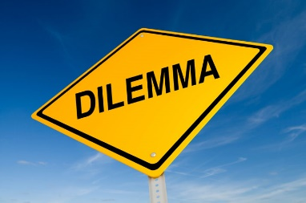

The Daily Dilemma
What are the, “good tidings of great joy” the angel spoke of?
One of your friends who is not religious recently saw a pair of missionaries talking with some people in the park. Your friend asked you, “Why do missionaries from your church go out and preach about Jesus? It seems like you’re trying to force your beliefs on other people?”
What have you learned about the Savior and His teachings that could bring people joy in this life and in the life to come?
Role play the situation above.

Slide 12
John 3:5
5 Jesus answered, Verily, verily, I say unto thee, Except a man be born of water and of the Spirit, he cannot enter into the kingdom of God.

Slide 13
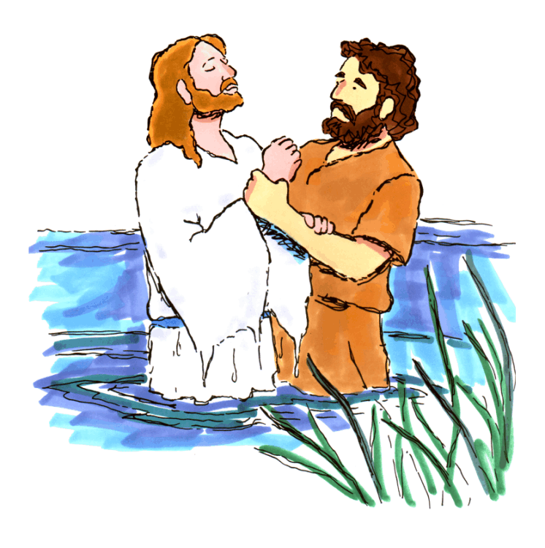
“Except a man be born of water and of the Spirit, he cannot enter into the kingdom of God.”
At Jesus’ baptism, John the Baptist witnessed all 3 members of the Godhead, when he held his arm to the square with his 5 fingers pointing heavenward.
This Is My
Beloved Son
5 Fingers
Notes:
This verse is talking about baptism. Who is the greatest example about baptism? Jesus.
And who baptized Jesus? John
How many members of the Godhead were present when Jesus was baptized? 3
How many fingers do you hold up when you baptize someone? 5

Slide 14
Memorizing
“J____ 3:_
E_____ a m__ b_ b___ o_ w____ a__ o_ t__ S_____, h_ c_____ e____ i___ t__ k______ o_ G__.”

Slide 15
The Daily Dilemma
What does it mean to be born of the water?
What does baptism witness to God?
What does it mean to be born of the Spirit? (Mosiah 27:25 & Alma 5:14)
Imagine that you have a friend named Meghan who is a member of the Church, but her mother is not. Her mother believes in Jesus Christ and the Bible but doesn’t belong to any particular church. Meghan asks you, “Can’t my mother go to heaven without being baptized if she lives a good life?”
Roleplay using John 3:5 as you help Meghan.

Slide 16
John 3:16
16 For God so loved the world, that he gave his only begotten Son, that whosoever believeth in him should not perish, but have everlasting life.

Slide 17
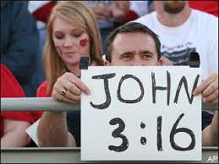
“For God so loved the world, that he gave his only begotten Son.”
The Beloved Apostle John knows the 3 members of the Godhead’s incredible love. This is even greater than the type of love you get when dating at 16.
Notes:
Which apostle was known as the, “Beloved”? John
How many members of the Godhead love us so much? All 3
This love is even greater than the love you can start feeling when dating at 16.

Slide 18
Memorizing
Unscramble the following:
God Son gave loved the only 16 For that his begotten John he world so 3
For God so loved the world, that he gave his only begotten Son –John 3:16
You can have them do this individually in their journal or assign each person a word and they come up to put on the board. Could also write a word on a 3 by 5 card and they put it on the board in order.

Slide 19
The Daily Dilemma
How is the word, “believeth” different than just accepting the existence of Jesus Christ?
When someone is giving you a difficult assignment and says, “I believe in you” what are they expressing? How is this similar to the faith and belief we must have in Jesus Christ?
Imagine you are a full-time missionary. You have been invited into a home by a friendly couple who has never heard about the Atonement of Jesus Christ. Share about God’s love in sending His Son.

Slide 20
Matthew 5:14-16
14 Ye are the light of the world. A city that is set on an hill cannot be hid.
15 Neither do men light a candle, and put it under a bushel, but on a candlestick; and it giveth light unto all that are in the house.
16 Let your light so shine before men, that they may see your good works, and glorify your Father which is in heaven.

Slide 21


“Let your light so shine before men.”
Mat will tell you to hold your Light with 5 fingers.
You can also be an Example by not going to dances till 14 and not dating till 16.
Dancing at 14
Dating at 16
WELCOME
Notes:
Think if you know a person named Matt. Imagine him being a light to the world.
How many fingers do you use when holding a flashlight? 5
We can also be good examples by not going to dances till 14 or dating till 16.

Slide 22
Memorizing
Break the class into 3 groups and assign each group one of the verses. Have them illistrate on the board or on a paper the major images found in their verse.

Slide 23
The Daily Dilemma
You are with a group of friends when a few of them start to tell dirty jokes and speak rudely about someone you know. You feel uncomfortable and know what they are doing is wrong. As you are wondering what to do, your friend Jesse, who is a member of a different religion and whom you really admire, turns to you and says, “Hey, why do you look so serious?”
Roleplay what you would hope to do in this situation, knowing we are to be a light to the world.

Slide 24
Matthew 11:28-30
28 Come unto me, all ye that labour and are heavy laden, and I will give you rest.
29 Take my yoke upon you, and learn of me; for I am meek and lowly in heart: and ye shall find rest unto your souls.
30 For my yoke is easy, and my burden is light.

Slide 25
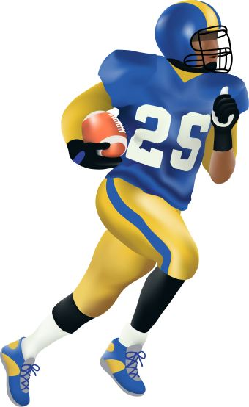
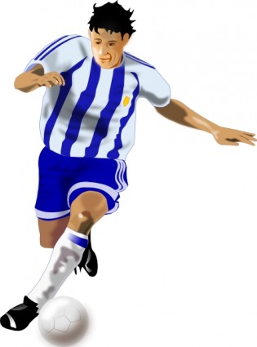
“Come unto me, all ye that labour and are heavy laden, and I will give you rest.”
Mat knows that Football and Soccer teams help Ease each other’s Burdens and give Rest by having 11 players on the field at a time, even if they have 28-30 on their teams.
WELCOME
Notes:
Imagine you have a friend named Matt who loves football and soccer.
How many players from each team are on the field at once? 11
Even though a team could have 28-30 players.

Slide 26
Memorizing
“Matthew __:28–__: Come unto m_, a__ ye that l____ a__ are heavy l____, and I will g___ you r___.”
The Doctrinal Mastery app could also help you memorize this key scripture phrase in a similar way.

Slide 27
The Daily Dilemma
What does this passage teach about our responsibility?
What does it teach about what the Savior will do for us as we come unto Him?
In two or three sentences, create a hypothetical scenario of a fictional person around your age who is currently weighed down by a burden. Include a name, a specific burden, and one or two details about how the person is feeling.
“I’m really stressed right now. I’m trying to stay close to the Lord, but things just keep piling up. School is hard, things aren’t great with my family right now, and I’m not sure how to handle everything. It doesn’t look like anything is going to get better either. I’m worried about all of it, and I don’t know what to do.”

Slide 28
Matthew 16:15-19
15 He saith unto them, But whom say ye that I am?
16 And Simon Peter answered and said, Thou art the Christ, the Son of the living God.
17 And Jesus answered and said unto him, Blessed art thou, Simon Bar-jona: for flesh and blood hath not revealed it unto thee, but my Father which is in heaven.
18 And I say also unto thee, That thou art Peter, and upon this rock I will build my church; and the gates of hell shall not prevail against it.
19 And I will give unto thee the keys of the kingdom of heaven: and whatsoever thou shalt bind on earth shall be bound in heaven: and whatsoever thou shalt loose on earth shall be loosed in heaven.

Slide 29
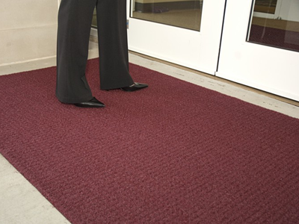
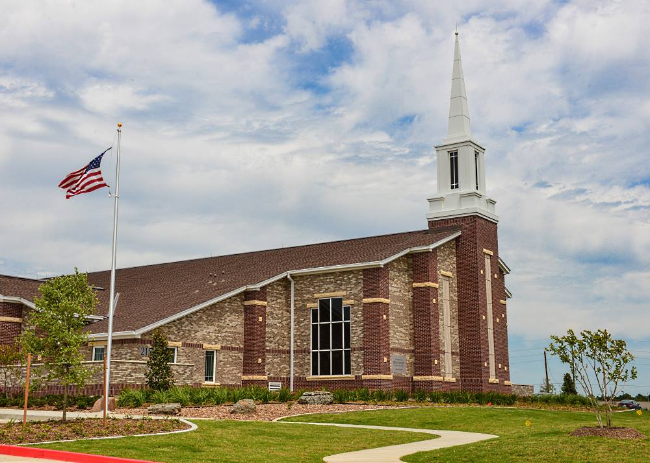
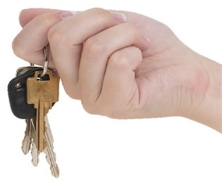
Jesus said, “I will give unto thee the keys of the kingdom.”
The Keys to the Kingdom are not under the door Mat of the Church. And they are not the kind of Keys you get when you can drive at 16. They are the kind of Keys a Teachers, or Elders Quorum President could have at ages 15-19.
Notes:
What is the first thing to step on when you enter a Church? A Mat
What do people often hide under a mat? Keys.
Will you find the keys of the Kingdom of God there? Will you get these keys when you can drive at (what age)? 16
Who has those keys? Teachers and Elders quorum presidents do who could be 15-19 years old.

Slide 30
Memorizing
Print out the slide with the entire passage of Matthew 16:15-19. Then cut out each row and mix them up. Have them reassemble the verses.

Slide 31
The Daily Dilemma
You are serving as a missionary, and you and your companion are teaching an investigator about the importance of baptism. When you invite your investigator to be baptized, she responds by asking, “Why do I need to be baptized again? I was already baptized in my church.”
How could the doctrine taught in Matthew 16:15–19 help your investigator find an answer to her question? Roleplay the situation.

Slide 32
Doctrinal Mastery Quiz
____ “Come unto me, all ye that labour and are heavy laden, and I will give you rest.”
____“For unto you is born this day in the city of David a Saviour, which is Christ the Lord.”
____ Jesus said, “I will give unto thee the keys of the kingdom.”
____“For God so loved the world, that he gave his only begotten Son.”
____“Except a man be born of water and of the Spirit, he cannot enter into the kingdom of God.”
____“Let your light so shine before men.”
Luke 2:10–12
John 3:5
John 3:16
Matthew 5:14–16
Matthew 11:28–30
Matthew 16:15–19

Slide 33
John 7:17
17 If any man will do his will, he shall know of the doctrine, whether it be of God, or whether I speak of myself.

Slide 34
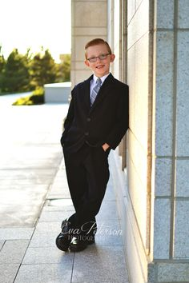
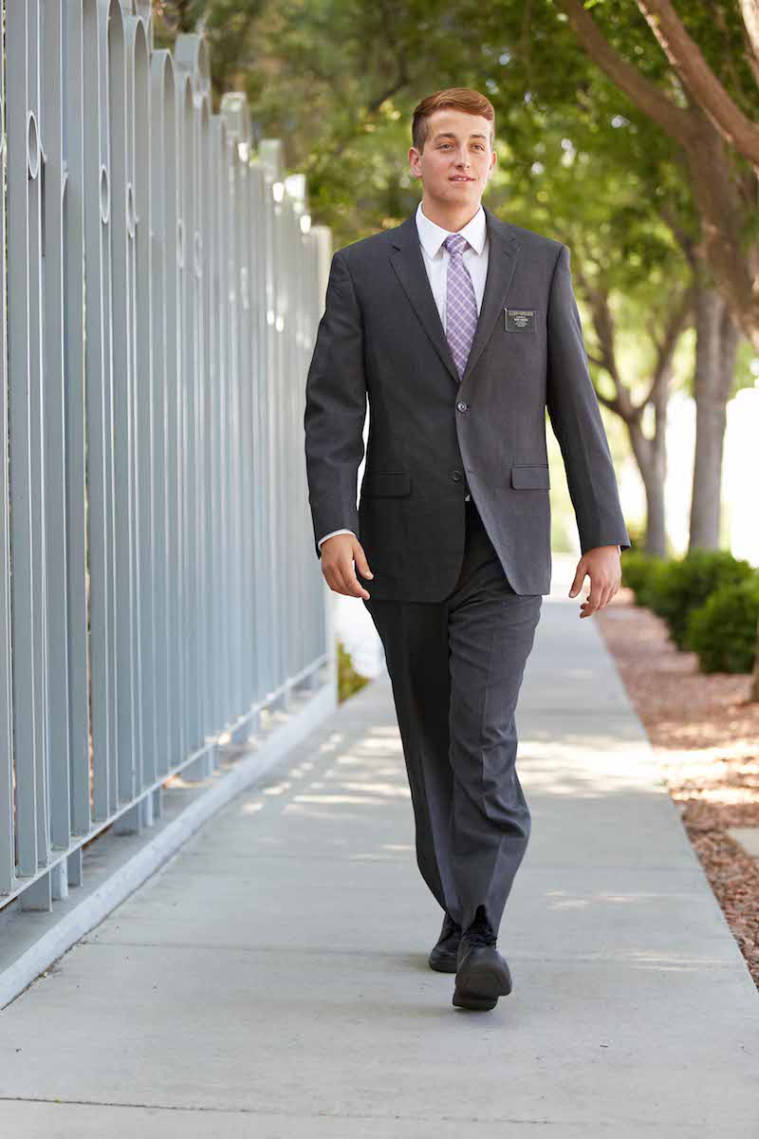
“If any man will do his will, he shall know of the doctrine.”
LI:L John, learned that if you want to Know if God’s Doctrine is true, you have to start to Do His Will before baptism (age 7) and before your mission (age 17).
“LI:L John”
LI:L upside down looks like 7:17
Notes:
LI:L’ John is also one of Robinhood’s merry men.

Slide 35
Memorizing
If any man will do his will,
he shall know of the doctrine,
whether it be of God, or whether I speak of myself.
Notes:
Break it into 3 parts and see if they can keep saying with parts removed. Papers may work better with the 3 parts on them.

Slide 36
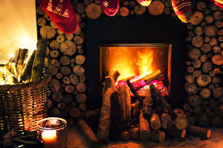
“You give me heat, and then I’ll give you some wood.”

Slide 37
The Daily Dilemma
What principle of seeking spiritual truth is being taught in this verse?
How can this verse help you better understand how you can seek spiritual truth?
What experiences have you had with this part of the pattern of acquiring spiritual truth?
As a missionary you are teaching Mario. He has a testimony of following Jesus Christ and the Book of Mormon and wants to be baptized. But he is not sure he believes in paying tithing and living the Word of Wisdom. Help him using John 7:17.

Slide 38
Matthew 22:36-39
36 Master, which is the great commandment in the law?
37 Jesus said unto him, Thou shalt love the Lord thy God with all thy heart, and with all thy soul, and with all thy mind.
38 This is the first and great commandment.
39 And the second is like unto it, Thou shalt love thy neighbour as thyself.

Slide 39
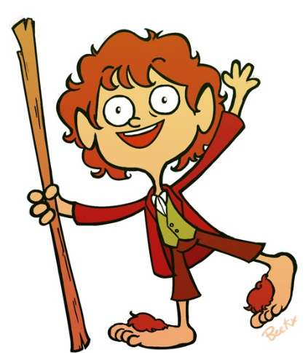

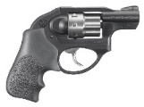
“Thou shalt love the Lord thy God… Thou shalt love thy neighbour.”
Mat knows that if you Love the Lord, you are not going to use a .22 on your Neighbor. Mat loves it when his hobbit neighbors stand on him because, they are only yard to a meter tall (36-39 inches), so they weigh less.
WELCOME
Notes:
Imagine a person names Mat being very loving.
And if you love your neighbor, you not going to use a …. What caliber gun? .22
Hobbits are how tall? Yard to a Meter. (36-39 inches)

Slide 40
Memorizing
36. M, w i t g c i t l?
37. J s u h, T s l t L t G w a t h, a w a t s, a w a t m.
38. T i t f a g c.
39. A t s i l u i, T s l t n a t.

Slide 41
The Daily Dilemma
What is the relationship between loving God and loving others?
Why do you think these two are the great commandments?
Stanton’s parents are divorced, and he spends most weekends with his dad. His dad doesn’t like Stanton going to church and purposely schedules things at the same time as church services. Stanton wants to spend time with his dad, but he also wants to obey the Lord by going to church.
Sarah keeps feeling promptings from the Holy Ghost to invite her friend Gabe to read the Book of Mormon, but she keeps ignoring the promptings because she knows Gabe is very active with his family in another religion and doesn’t want to offend him.

Slide 42
John 17:3
3 And this is life eternal, that they might know thee the only true God, and Jesus Christ, whom thou hast sent.

Slide 43
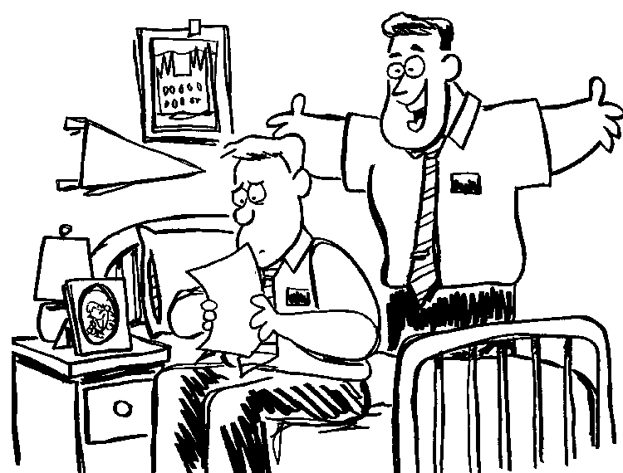
“And this is life eternal, that they might know thee the only true God, and Jesus Christ.”
She wrote, “Dear John, I am not going to write you anymore. I have found a guy who takes me to R-rated movies (age 17).”
You dodged bullet Elder. A girl like that doesn’t Know God. She is not in tune with the 3rd member of the Godhead.
Notes:
What group really know God? Missionaries.
What is the worst kind of letters they get? Dear Johns
If you want to know God better, what kind of movies are you going to avoid? R rated (17)
And a girl like that is not in tune with What member of the Godhead? 3rd

Slide 44
Memorizing
Write the entire verse and reference on the board. As a class, recite it together and then invite a student to erase 2 or 3 words and then recite it again. Repeat till the board is empty.

Slide 45
The Daily Dilemma
After fast and testimony meeting, you notice that your friend Julia seems sad. As you walk home with her, she says that during the meeting today she realized she doesn’t know Heavenly Father and Jesus Christ as well as she wants to. She describes a feeling of loneliness and a longing for the kind of relationship with Them that she sensed in some of those who shared their testimonies.
Share what you think it means to “Know God”.
How does this relate to having a relationship with God?
How does one have a relationship with God?

Slide 46
Luke 22:19-20
19 And he took bread, and gave thanks, and brake it, and gave unto them, saying, This is my body which is given for you: this do in remembrance of me.
20 Likewise also the cup after supper, saying, This cup is the new testament in my blood, which is shed for you.

Slide 47
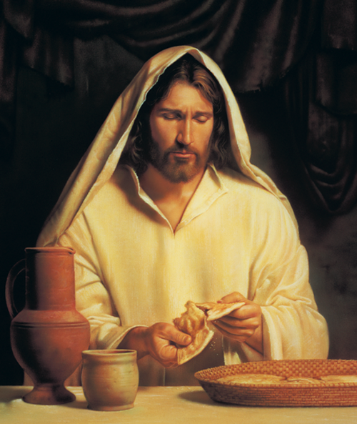
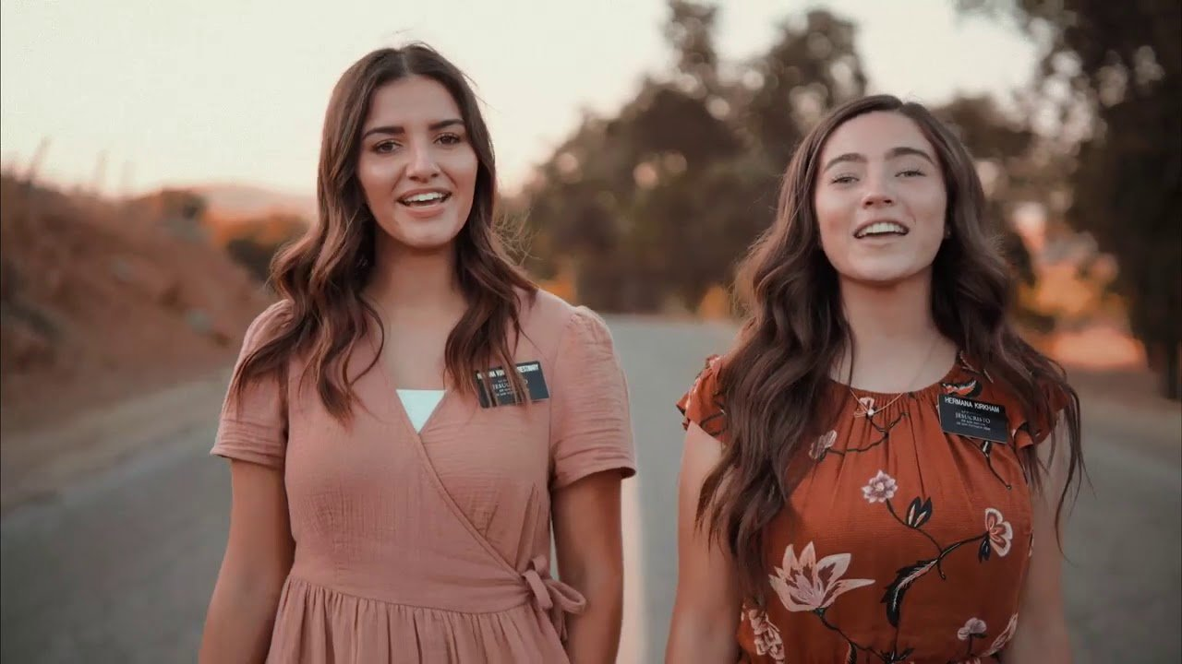
Jesus Christ commanded, partake of the sacrament “in remembrance of me.”
Luke was not there when Jesus gave the Sacrament to his disciples. Sister missionaries teach others to remember Jesus and the Sacrament as they go out on missions 2 by 2 (22). They leave at 19 years old and return at 20.
Notes:
What group really know God? Missionaries.
What is the worst kind of letters they get? Dear Johns
And a girl like that is not in tune with What member of the Godhead? 3rd

Slide 48
Memorizing
Print out the slide with the entire passage of Luke 22:19-20. Then cut out each row and mix them up. Have them reassemble the verses.

Slide 49
The Daily Dilemma
What are ways to remember the Savior as you take the Sacrament.
What are the 3 promises we make with God when we partake of the sacrament? What does God promise in return? See Doctrine & Covenants 20:77.
Why is it important to think about what you are promising when partaking of the Sacrament.
Who does each pronoun in the prayer refer to?

Slide 50
Luke 24:36-39
?
36 And as they thus spake, Jesus himself stood in the midst of them, and saith unto them, Peace be unto you.
37 But they were terrified and affrighted, and supposed that they had seen a spirit.
38 And he said unto them, Why are ye troubled? and why do thoughts arise in your hearts?
39 Behold my hands and my feet, that it is I myself: handle me, and see; for a spirit hath not flesh and bones, as ye see me have.

Slide 51

“For a spirit hath not flesh and bones, as ye see me have.”
I, Luke, the pediatric doctor, stay on call 24 hours a day. I’ve never operated on a Spirit, but most Bodies I treat are between a yard and a meter long (36-39 inches).
Dr. Luke’s
Pediatrics
On Call
24 Hours
Notes:
What is the profession that works most with bodies of flesh and bone? Doctors
Which Gospel writer was actually a doctor? Luke
The most hours a doctor could be on call is? 24
Pediatricians work on kids that are usually a yard stick to a meter high. 36-39 inches.

Slide 52
Memorizing
Print out the verses on separate pages and have a class member put them in order. Then invite another.

Slide 53
The Daily Dilemma
According to this passage, what did the Savior do to witness to His disciples that He had risen from the dead with a glorified physical body?
One of your close friends, Kim, has agreed to take the missionary lessons in your home. When taught the plan of salvation and the role of Jesus Christ, Kim seems uncomfortable but doesn’t say anything. Later, after the missionaries leave, he shares with you that he does believe in life after death, but not with bodies but instead, just as spirits. Roleplay and help Kim understand better using Luke 24:36-39

Slide 54
1 Corinthians 6:19-20
19 What? know ye not that your body is the temple of the Holy Ghost which is in you, which ye have of God, and ye are not your own?
20 For ye are bought with a price: therefore glorify God in your body, and in your spirit, which are God’s.

Slide 55
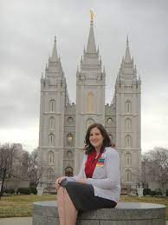
“Your body is the temple of the Holy Ghost.”
The 1st thing Corin is going to do before her mission is to go through the Salt Lake Temple which has 6 Spires.
She has been keeping her Body healthy so she will be 19 years old when she leaves and will come back when she is 20.
Notes:
Imagine you have a friend named Corin who is about to go on a mission.
What important event needs to happen before leaving? Temple
How many spires does the Salt Lake temple have? 6
If a young lady went right away, how old would she be when she left and returned? 19-20

Slide 56
Memorizing
Holy Corinthians is 1 the body Ghost 19-20 temple Your the of
Put the above Scripture Phrase and reference in order.

Slide 57
The Daily Dilemma
According to the verses, why are our bodies special?
Point out something in each verse that teaches that we need to try and keep our bodies healthy.
Point out anything that relates to the Law of Chastity.
With a partner, make up a scenario where sharing 1 Corinthians 6:19-20 would be very helpful. Share.

Slide 58
Doctrinal Mastery Quiz
____ “And this is life eternal, that they might know thee the only true God, and Jesus Christ.”
____ “If any man will do his will, he shall know of the doctrine.”
____ “For a spirit hath not flesh and bones, as ye see me have.”
____ “Your body is the temple of the Holy Ghost.”
____ “Thou shalt love the Lord thy God. … Thou shalt love thy neighbour.”
____ “Jesus Christ commanded, partake of the sacrament “in remembrance of me.”
John 7:17
Matthew 22:36-39
John 17:3
Luke 22:19-20
Luke 24:36-39
1 Corinthians 6:19-20

