Slide 1
Doctrinal Mastery Helps Spring 2022 Old Testament
Moses 1:39
Moses 7:18
Abraham 2:9-11
Abraham 3:22-23
Genesis 1:26-27
Genesis 2:24
1st Term Quiz
Genesis 39:9
Exodus 20:3-17
Joshua 24:15
Psalm 24:3-4
Proverbs 3:5-6
Isaiah 1:18
2nd Term Quiz

Slide 2
Doctrinal Mastery Helps Fall 2022 Old Testament
Isaiah 5:20
Isaiah 29:13-14
Isaiah 53:3-5
Isaiah 58:6-7
Isaiah 58:13-14
Jeremiah 1:4-5
1st Term Quiz
Ezekiel 3:16-17
Ezekiel 37:15-17
Daniel 2:44-45
Amos 3:7
Malachi 3:8-10
Malachi 4:5-6
2nd Term Quiz

Slide 3
Books of the Old Testament (Tanakh)
Joshua
2nd Kings
Judges
1st Chronicles
Ruth
2nd Chronicles
Leviticus
Genesis
Exodus
Numbers
Deuteronomy
1st Samuel
Ezra
2nd Samuel
Nehemiah
1st Kings
Esther
The Law (Torah)
Historical Writing
Hosea
Nahum
Joel
Habakkuk
Amos
Zephaniah
Psalms
Jeremiah
Ecclesiastes
Song of Solomon
Proverbs
Isaiah
Job
Lamentations
Daniel
Ezekiel
Obadiah
Haggai
Jonah
Zechariah
Micah
Malachi
Poetic Writings
Major Prophets
Minor Prophets

Slide 4
A Little Explanation
With Doctrinal Mastery, although memorization is not emphasized as it was, we are still to help our students know the passages, understand them, and help them be able to know the references to the passages. By studying the Doctrinal Mastery Materials, you will see that they give time to each topic according to how many Doctrinal Mastery Passages there are for that topic. In other words, you can take a week to spotlight each passage and help your students get to know that passage better.
To spotlight a scripture for the week, it takes about 5 minutes each day. It is good to have the class recite the verse in unison each day (first slide). Then do one of the following on different days.
Ask the class why that verse is important and why it was chosen. How does it support the Doctrinal Mastery Topic? Have them highlight the verse(s) in their scriptures, and underline key words
Share the mnemonic (second slide). See helps to sharing a mnemonic on the next slide.
Share a scenario, questions, or some activity to help them explain and apply the doctrine. With this they can discuss or roleplay with their partner (third slide).
There are about 36 weeks in a school year and 24 Doctrinal Mastery Passages, so you can review and quiz with the students to help them on weeks without a passage, or spend extra time on some passages. We might also look at Doctrinal Mastery Passages from other years. I have also included a quiz and review after ever 6 passages learned in a term.

Slide 5
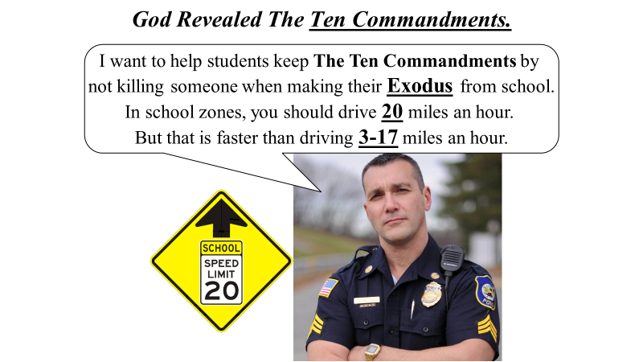
Steps To Using The Old Testament Doctrinal Mastery Mnemonics
Keep the key words of the scripture in mind (especially the underlined words).
Link the key words to an idea or image in the cartoon mnemonic.
Link the idea to the reference embedded in the cartoon mnemonic.
Practice with a friend, with them saying the key words, and you giving the reference.
Give hints from the mnemonic.

Slide 6
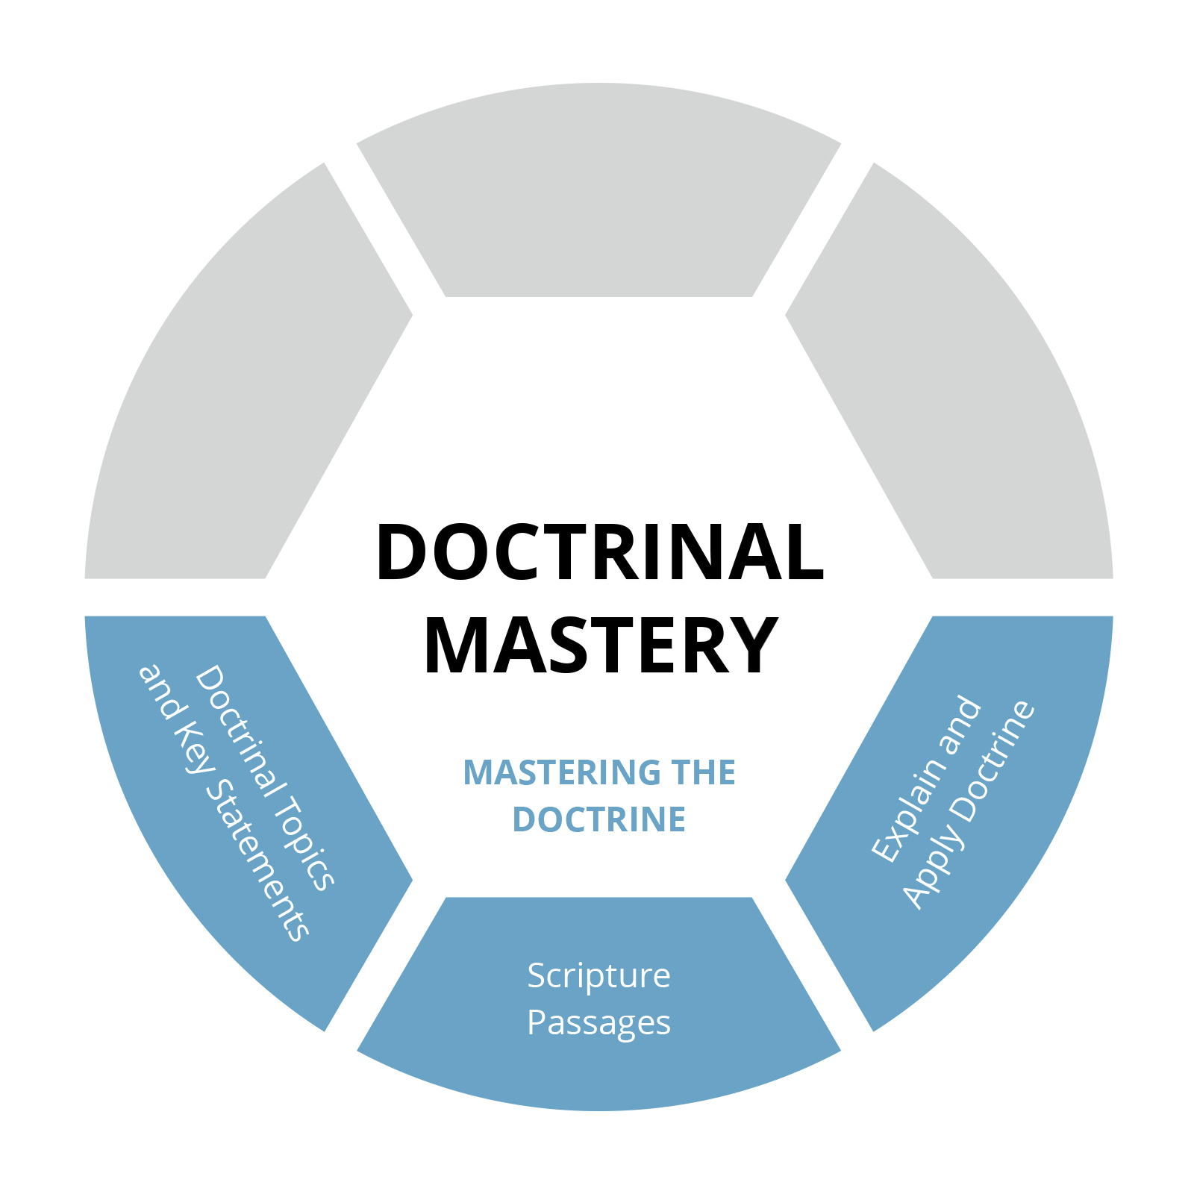
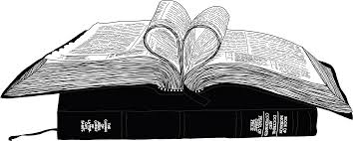
Doctrinal
Mastery

Slide 7
Fall 2022

Slide 8
Isaiah 5:20
Acquiring Spiritual Knowledge
20 Woe unto them that call evil good, and good evil; that put darkness for light, and light for darkness; that put bitter for sweet, and sweet for bitter!

Slide 9
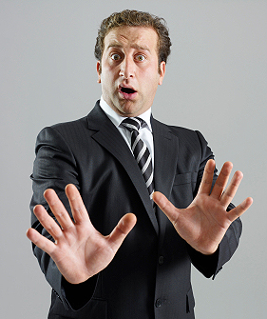
“Woe unto them that call evil good, and good evil.”
Woe! I-say-yah (Isaiah) you’ll be talking to our hands
(5 fingers) if you want to Call Evil Good and good evil.
With me and my twin, that adds up to 20 fingers.
I
I
Notes:
When you say “Woe” you hold your 5 fingers out.
Call Evil Good
You don’t want to do that.
How many fingers is he holding up on each hand?
How many fingers are they holding up?

Slide 10
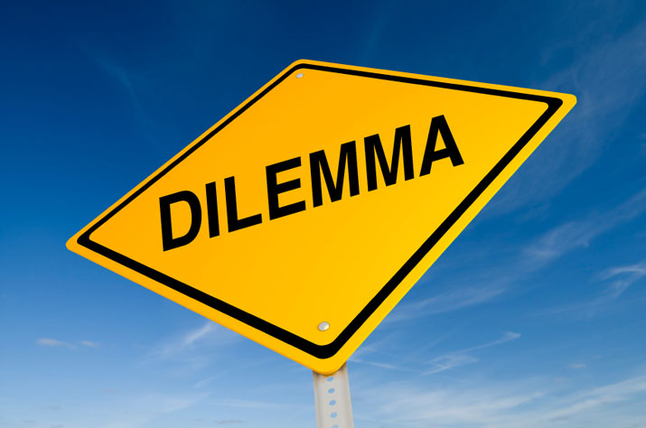
The Daily Dilemma
What are some current examples of spiritually dangerous ideas and actions that can appear to be attractive, desirable, or pleasurable?
In one of Raquel’s classes at school, the topic of abortion was discussed. Raquel had always felt that abortion was wrong, so she was surprised to hear how many of her classmates seemed to be in favor of it. Raquel decided to do more research on the topic after school. She felt sad when she learned that tens of millions of people around the world choose to end their pregnancies with an abortion each year. As she continued her research, she read many perspectives that made it seem that abortion was something to be celebrated, while those who opposed it were labeled as closed-minded or out of touch. After her research, Raquel wondered, “Am I wrong to be opposed to abortion?”
What thoughts do you have about Raquel’s question?

Slide 11
Isaiah 29:13-14
The Restoration
13 Wherefore the Lord said, Forasmuch as this people draw near me with their mouth, and with their lips do honour me, but have removed their heart far from me, and their fear toward me is taught by the precept of men:
14 Therefore, behold, I will proceed to do a marvellous work among this people, even a marvellous work and a wonder: for the wisdom of their wise men shall perish, and the understanding of their prudent men shall be hid.

Slide 12
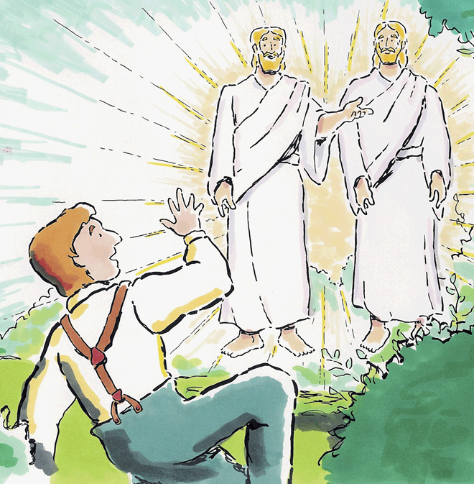
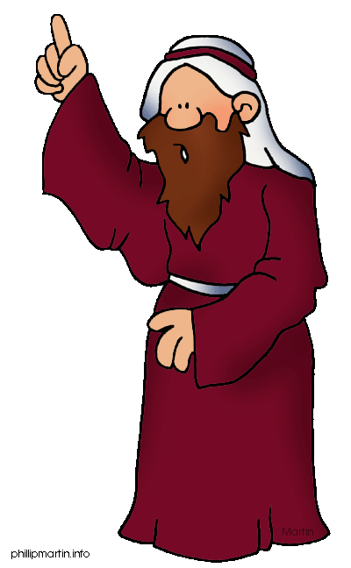
The Restoration of the gospel is “a marvellous work and a wonder.”
February 1820
29
I-see-ah ( Isaiah ) boy who, on a leap year (Feb. 29),
read the scriptures at age 13 and prayed to God at age 14,
which would bring the Restoration of the Gospel.
What A Marvellous Work and a Wonder!
Notes:
A Marvelous Work and A Wonder
There is that guy saying “I Say Ah” again.
What was a Marvelous work and wonder? = Started with the first vision
Did you know that was a leap year? How are those years different in February? 29 days.
How old was Joseph when he started to pray about which church to join?
What age when the vision happed?

Slide 13
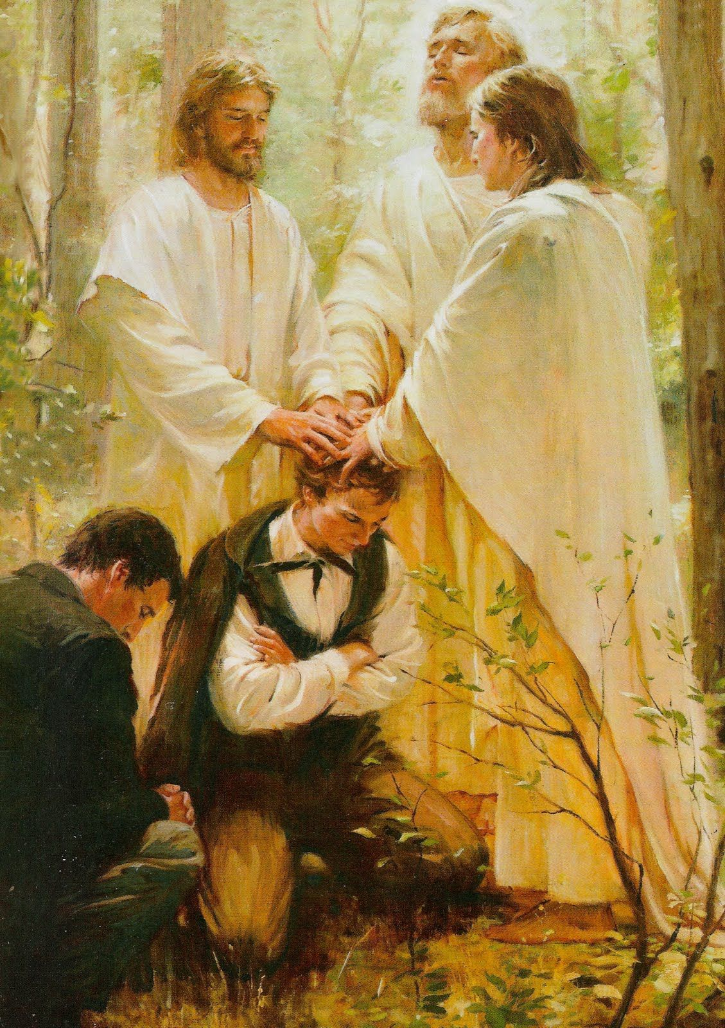
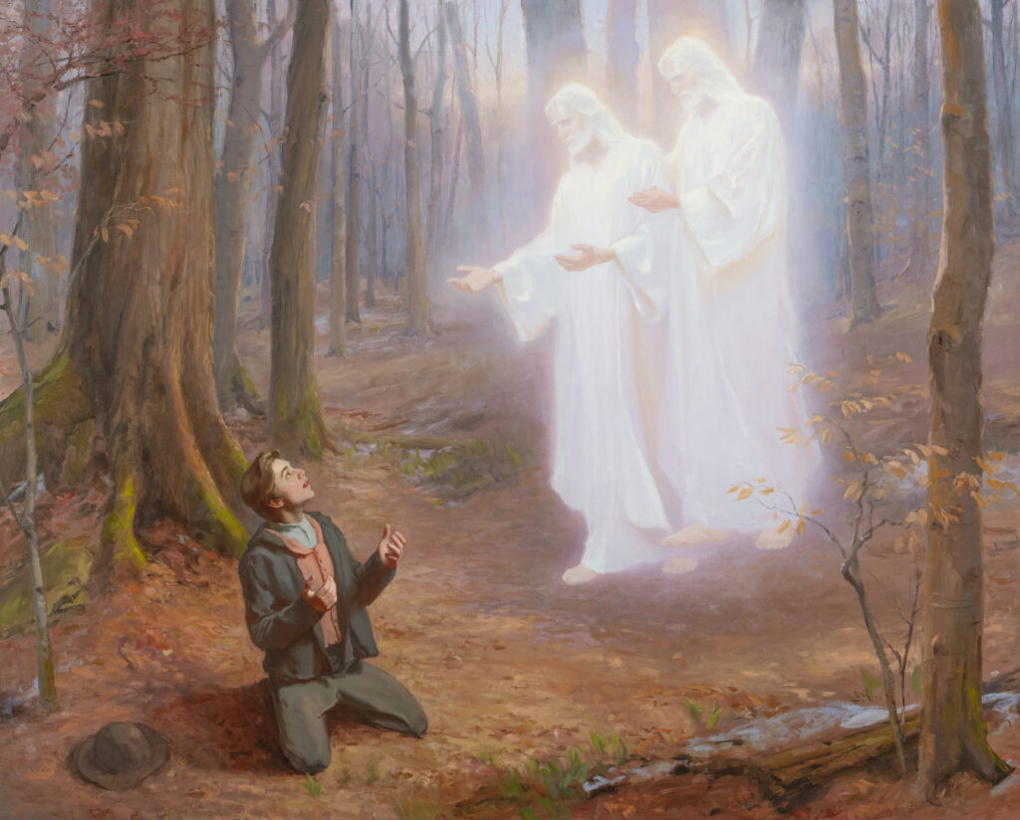
The Restoration of the gospel is “a marvellous work and a wonder.”
I-say-yah ( Isaiah ), 1829 was a big year for the Restoration
The Priesthood was Restored and the Book of Mormon translated.
Before that, Joseph read the scriptures at age 13 and prayed to
God at age 14, which would bring the Restoration of the Gospel.
What A Marvelous Work and a Wonder!
Notes:
A Marvelous Work and A Wonder
There is that guy saying “I Say Ah” again.
What was a Marvelous work and wonder? = Started with the first vision
Did you know that was a leap year? How are those years different in February? 29 days.
How old was Joseph when he started to pray about which church to join?
What age when the vision happed?

Slide 14
The Daily Dilemma
What are some blessings Jesus Christ made available through the Restoration of His gospel? List at least three.
Why might you describe these blessings as wonderful and marvelous?
How could the coming forth of the Book of Mormon be considered a marvelous work and a wonder?
What experiences have you had in which studying the Book of Mormon and applying its teachings have helped you come closer to Jesus Christ?

Slide 15
The Daily Dilemma
You have been looking for opportunities to talk about the gospel of Jesus Christ. On the bus one morning, someone sits down next to you and asks you how you are doing. You put away your phone and return the stranger’s greeting by responding, “I am doing great! I was just reading the Book of Mormon. Have you read it?” The stranger’s response is quick and rather hurtful. “Oh, I know all about that book! I just cannot believe it came from God. Angels talking to a farm boy in the woods? Golden plates? I just cannot believe that God works that way.”
Write a response addressing the idea that the coming forth of the Book of Mormon sounds too unbelievable. As part of your response, consider answering each of the following questions:
How could your understanding of Isaiah 29:13–14 and its key scripture phrase, The Restoration of the gospel is “a marvellous work and a wonder,” help you respond?
How could an eternal perspective help in viewing the miraculous events surrounding the coming forth of the Book of Mormon?
What could you invite your new friend to do to find out the truth about the Restoration of the gospel of Jesus Christ?

Slide 16
Isaiah 53:3-5
The Atonement of Jesus Christ
3 He is despised and rejected of men; a man of sorrows, and acquainted with grief: and we hid as it were our faces from him; he was despised, and we esteemed him not.
4 Surely he hath borne our griefs, and carried our sorrows: yet we did esteem him stricken, smitten of God, and afflicted.
5 But he was wounded for our transgressions, he was bruised for our iniquities: the chastisement of our peace was upon him; and with his stripes we are healed.

Slide 17
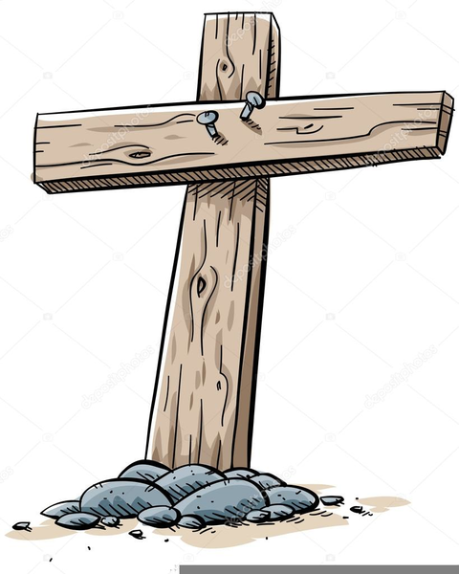
“Surely [Jesus Christ] hath borne our griefs, and carried our sorrows.”
I-see-ah ( Isaiah ) vision of
Jesus Christ and prophesy
that He will be hung on
a Filthy Tree (53).
After He Suffers for our
sins and Sorrows, they
will remove His body
from the cross between
3-5 PM.
Notes:
Jesus Suffered.
I-See-Ah….
The cross could be called a filthy tree (53). Acts 5:30; 10:39; 13:29…
Do you know what time they took Jesus’ body from the cross? 3-5pm.

Slide 18
The Daily Dilemma
You know your friend has been struggling with some difficult trials. When you ask him what you can do to help, he says, “No one understands what I’m going through or how I feel. I just have to deal with my problems myself.” Share Isaiah 53:3-5 to help your friend.
As you read the lyrics or listen to the hymn “Where Can I Turn for Peace?” (Hymns, no. 129), ponder if you know anyone (including yourself) who has wondered who they could turn to for help as they go through difficulties.

Slide 19
Isaiah 58:6-7
Commandments
6 Is not this the fast that I have chosen? to loose the bands of wickedness, to undo the heavy burdens, and to let the oppressed go free, and that ye break every yoke?
7 Is it not to deal thy bread to the hungry, and that thou bring the poor that are cast out to thy house? when thou seest the naked, that thou cover him; and that thou hide not thyself from thine own flesh?

Slide 20
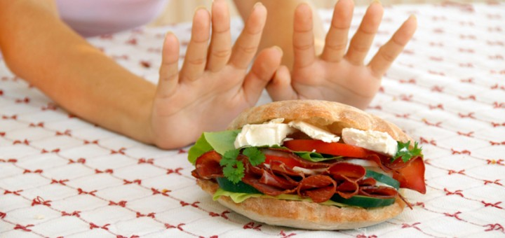
The blessings of a proper fast.
I-say-ah (Isaiah) even old people at age 58
should Fast each month. 6-7 year olds should
also start considering Fasting.
Notes:
Fast,
Did you know there are some age factors? 58 should fast
6-7 year olds should start considering it.

Slide 21
The Daily Dilemma
Imagine you have a friend not of your faith staying with you over the first weekend of the month. At dinner, the topic of the upcoming fast Sunday is brought up, and your family discusses ideas or needs they are aware of to include in their fast. After the meal, your friend asks you about fasting, wondering what it is, why people fast, and how often they have to do it. Use Isaiah 58:6-7 to help share with your friend.
Sierra was recently encouraged by her parents to start obeying the law of the fast by going without food or drink for two meals. Sierra believes in the principle of fasting but has some major reservations about it because she feels that it would be too difficult for her. How can you encourage Sierra to act in faith?

Slide 22
Isaiah 58:13-14
Commandments
13 If thou turn away thy foot from the sabbath, from doing thy pleasure on my holy day; and call the sabbath a delight, the holy of the Lord, honourable; and shalt honour him, not doing thine own ways, nor finding thine own pleasure, nor speaking thine own words:
14 Then shalt thou delight thyself in the Lord; and I will cause thee to ride upon the high places of the earth, and feed thee with the heritage of Jacob thy father: for the mouth of the Lord hath spoken it.

Slide 23
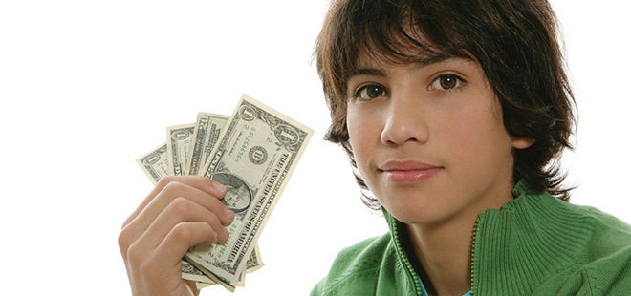
“Turn away … from doing thy pleasure on my holy day; and call the sabbath a delight.”
I-say-ah (Isaiah) even if you are planning
a thrifty date (58), you shouldn’t spend
money on the Sabbath. Especially if you
are only 13-14 years old.
Notes:
Sabbath
Don’t go spending money on a date on the Sabbath.
Even a “Thrify Date” 58
13-14 year olds should not be dating.

Slide 24
The Daily Dilemma
Your brother comes to you with a concern about the commandment to keep the Sabbath day holy. He is frustrated with your parents because he doesn’t want to participate in some of the Sabbath-day activities they have planned. He says, “The way we’re supposed to spend Sundays is so boring and feels like a waste of time. Don’t you think our weekends would be so much better if we didn’t have to worry about keeping the Sabbath day holy?”
What are some reasons your brother might be frustrated with this commandment?
What are some things your brother might not yet understand about the Sabbath day?
What would you want Him to know about the Lord and His purposes for giving us the Sabbath day?
What are some specific teachings from Isaiah 58:13–14 that could help?

Slide 25
Jeremiah 1:4-5
Prophets and Revelation
4 Then the word of the Lord came unto me, saying,
5 Before I formed thee in the belly I knew thee; and before thou camest forth out of the womb I sanctified thee, and I ordained thee a prophet unto the nations.

Slide 26
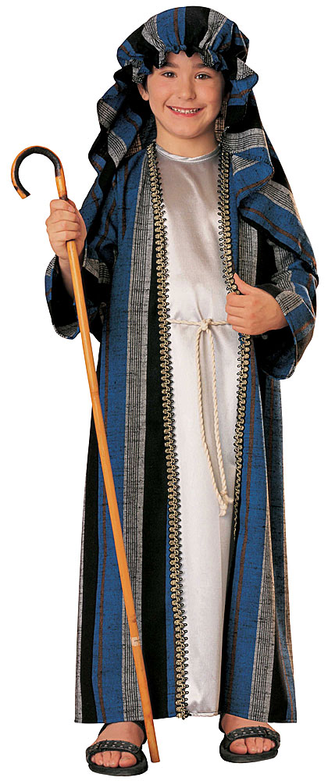
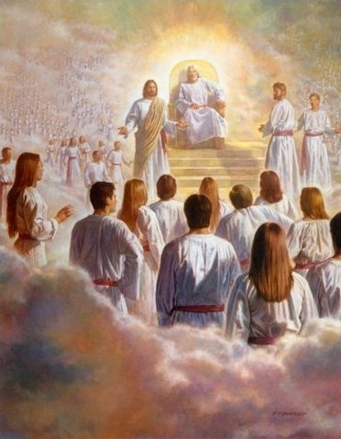
“Before I formed thee in the belly… I ordained thee a prophet unto the nations.”
Jeremiah was foreordained
before his 1st year of life and
was already a good boy when
in preschool (4-5 years old).
Notes:
Jeremiah
Do you know this kids name? Jeremiah.
Foreordained before his 1st Year of life.
How old does he look? Preschool 4-5

Slide 27
The Daily Dilemma
What two major doctrines are taught in these verses?
Imagine you are watching general conference with your family and your friend Stella, who recently became a member of the Church. After the leaders of the Church are sustained, Stella becomes curious and asks, “So, how is the prophet selected to be in his position? Is there an election with a vote or a committee that chooses who the prophet will be?” Stella is surprised when you explain that Church leaders are chosen by inspiration and that the senior Apostle is the one who is sustained as the President of the Church. She asks, “Don’t you think there must be a better way to make sure the best or the most qualified candidate is selected to be the prophet?”

Slide 28
Doctrinal Mastery Reference Quiz
____ “Surely [Jesus Christ] hath borne our griefs, and carried our sorrows.”
____ The blessings of a proper fast
____ “Woe unto them that call evil good, and good evil.”
____ “Before I formed thee in the belly . . . I ordained thee a prophet unto the nations.”
____ “Turn away . . . from doing thy pleasure on my holy day; and call the sabbath a delight.”
____ The restoration of the gospel is “a marvellous work and a wonder.”
Isaiah 5:20
Isaiah 29:13-14
Isaiah 53:3-5
Isaiah 58:6-7
Isaiah 58:13-14
Jeremiah 1:4-5

Slide 29
Ezekiel 3:16–17
Prophets and Revelation
16 And it came to pass at the end of seven days, that the word of the Lord came unto me, saying,
17 Son of man, I have made thee a watchman unto the house of Israel: therefore hear the word at my mouth, and give them warning from me.

Slide 30
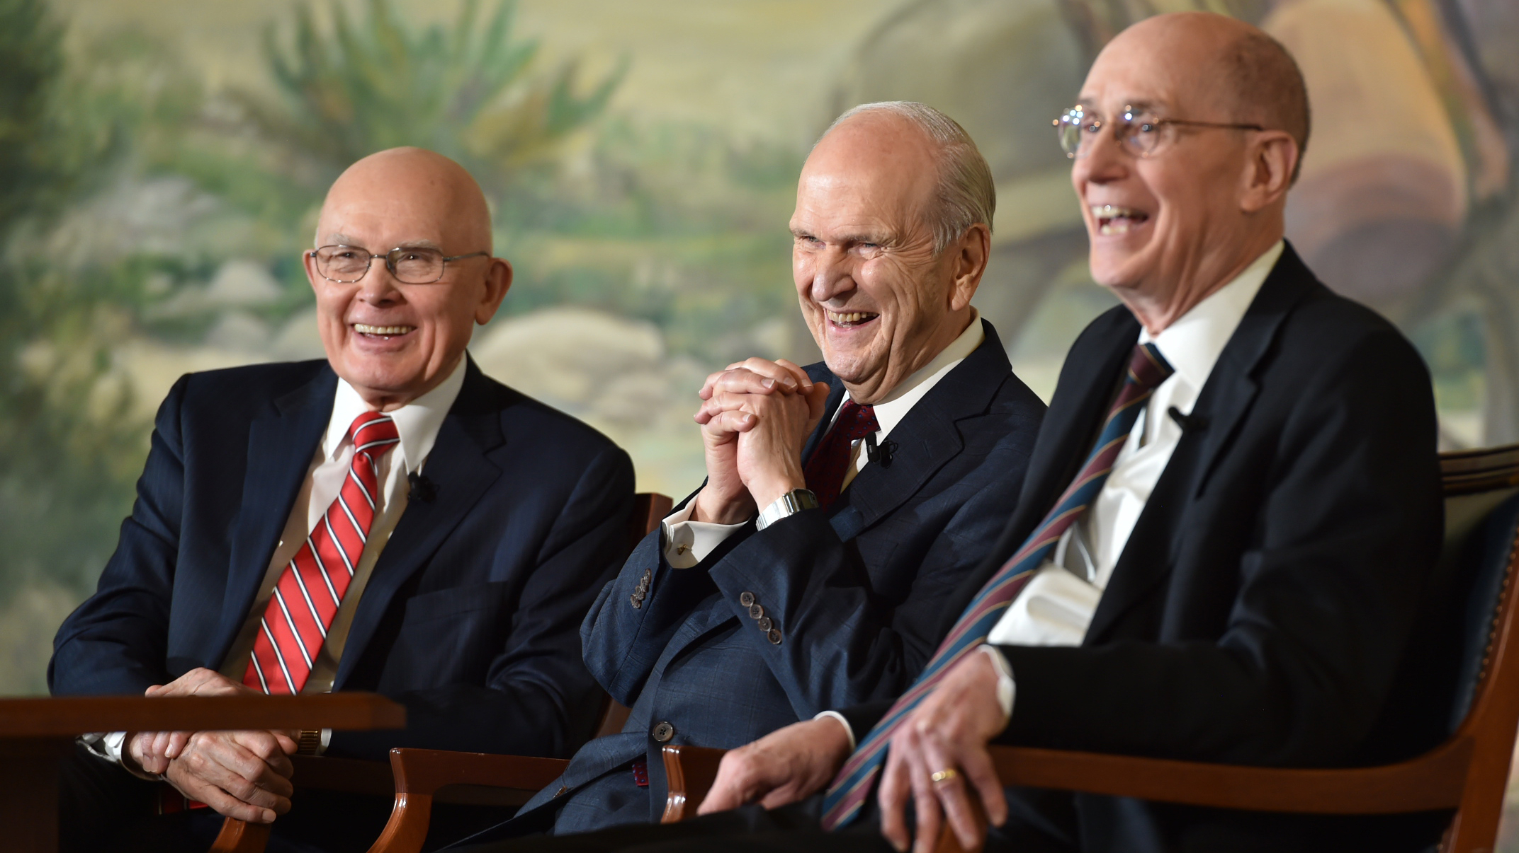
The prophet is “a watchman unto the house of Israel.”
It’s Easy (Ezekiel) to remember that the 3 members
of the First Presidency are Prophets who Watch over
the House of Israel. Even 16-17 year-olds know that.
Notes:
Jeremiah
Do you know this kids name? Jeremiah.
Foreordained before his 1st Year of life.
How old does he look? Preschool 4-5

Slide 31
The Daily Dilemma
What role did the Lord play in helping Ezekiel warn the people?
What can we learn from these verses about why the Lord calls prophets?
Choose a section from For the Strength of Youth Booklet that you feel best addresses the most relevant dangers you and your peers might face. Look for the following:
Standards the Lord is inviting you to live by
Potential spiritual dangers of ignoring the Lord’s counsel
Promised blessings for heeding the Lord’s instructions and warnings
Make up a scenario in which the For the Strength of Youth booklet has helpful advice.

Slide 32
Ezekiel 37:15–17
The Restoration
16 Moreover, thou son of man, take thee one stick, and write upon it, For Judah, and for the children of Israel his companions: then take another stick, and write upon it, For Joseph, the stick of Ephraim, and for all the house of Israel his companions:
17 And join them one to another into one stick; and they shall become one in thine hand.

Slide 33
The Bible and the Book of Mormon “shall become one in thine hand.”
On this Easel (Ezekiel),
which is one inch over a
yard high (37 inches), is a
picture of the stick of Joseph
and the stick of Judah. Each
weighs about a pound, give
or take an ounce (15-17)
Joseph
Judah
One yard plus an inch ( 37 )
Notes:
Stick
Did you know an Easel is made of sticks?
Ezekiel
How long is this one? 37
The scrolls of scriptures were also called sticks.
How much did they weigh?
How much did those wa

Slide 34
The Daily Dilemma
Shea has recently started receiving lessons from the full-time missionaries. He has enjoyed listening to them and feels good about the message they are sharing. The missionaries recently taught him about the Book of Mormon. Shea had always been taught that the Bible contains all of God’s words and that there is no need for additional scripture. While Shea does not want to disbelieve what the missionaries are telling him, he does wonder how it could possibly be true, considering what he has been taught. When the missionaries pause to ask if he has any questions, Shea asks, “Why do we need the Book of Mormon when we already have the Bible?”

Slide 35
Daniel 2:44-45
The Restoration
44 And in the days of these kings shall the God of heaven set up a kingdom, which shall never be destroyed: and the kingdom shall not be left to other people, but it shall break in pieces and consume all these kingdoms, and it shall stand for ever.
45 Forasmuch as thou sawest that the stone was cut out of the mountain without hands, and that it brake in pieces the iron, the brass, the clay, the silver, and the gold; the great God hath made known to the king what shall come to pass hereafter: and the dream is certain, and the interpretation thereof sure.

Slide 36
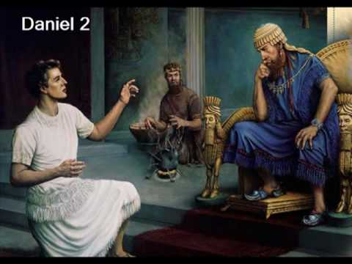
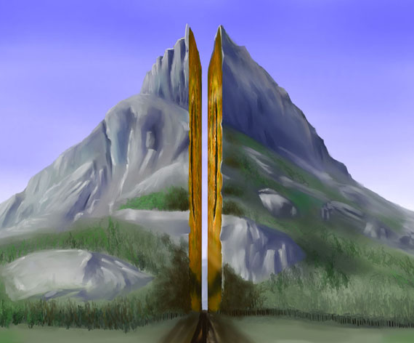
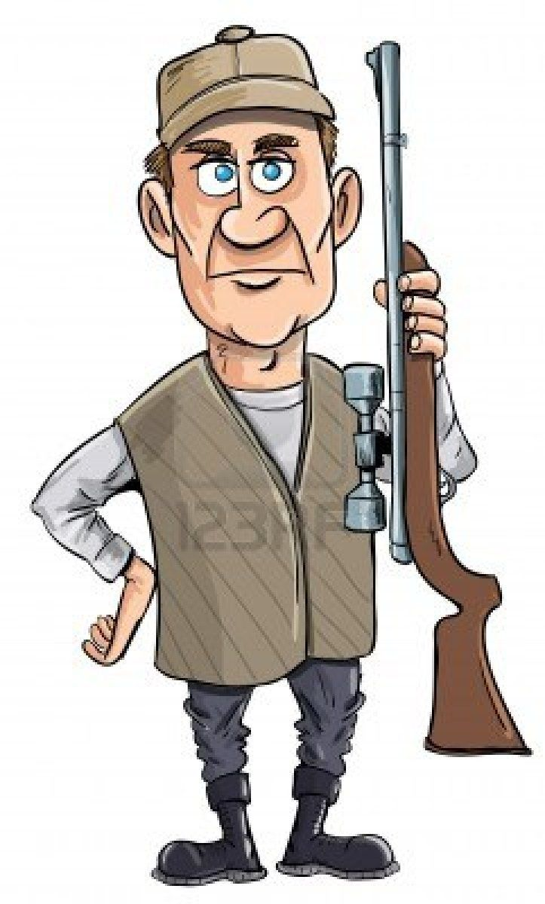
God shall “set up a kingdom, which shall never be destroyed.”
Daniel said the mountain would split in 2.
And it didn’t even take a .44 or .45 caliber rifle.

Slide 37
The Daily Dilemma
How do you see Daniel’s prophecy being fulfilled today?
What does the growth of the Church despite its humble beginnings help you understand about the Savior’s power?
What can you do to help The Church of Jesus Christ of Latter-day Saints fill the whole earth and stand forever?
Jessica notices many people at school and online saying negative things about the Church. Some of her loved ones have even lost their faith and ended up leaving the Church. In addition, the nation where Jessica lives has experienced a decline in the number of people who believe in Jesus Christ or belong to any religion. Jessica is beginning to wonder if the Church will even be around in the future. This thought leaves her feeling discouraged and worried.

Slide 38
Amos 3:7
Prophets and Revelation
7 Surely the Lord God will do nothing, but he revealeth his secret unto his servants the prophets.

Slide 39
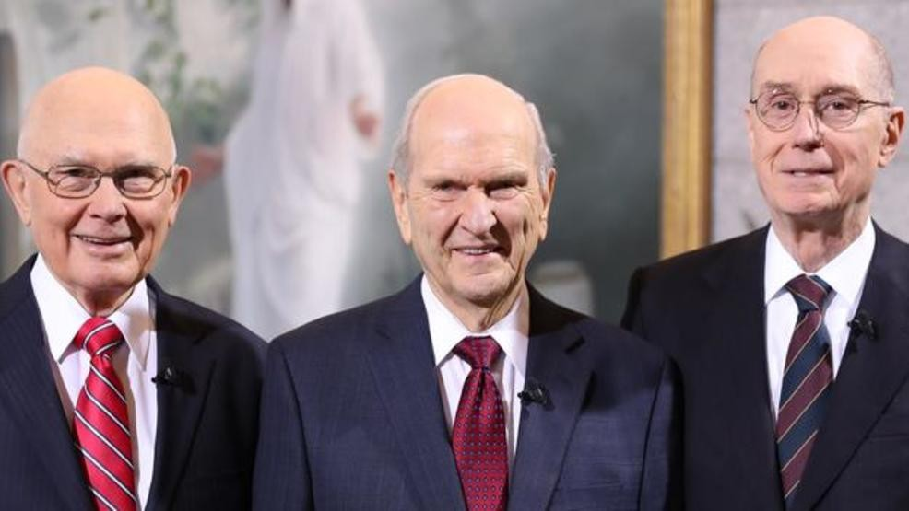
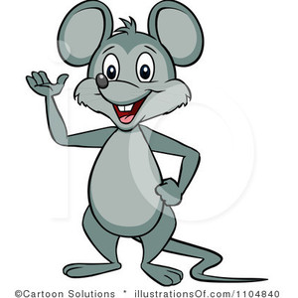
“The Lord God … revealeth his secret unto his servants the prophets.”
Whispered Secrets can make the
noise A-Mouse (Amos) makes.
This mouse knows God reveals
His secrets to the 3 prophets
in the First Presidency to help
us get to Heaven (7).”
Notes:
Secrets
When you are whispering a secret, it can sound like the sound A Mouse (Amos) makes. Spsss Spsss…
How many prophets does God reveal His secrets to in the First Presidency?
That helps us get to Heaven.

Slide 40
The Daily Dilemma
An investigator is a bit shocked and disturbed to hear that we believe in prophets today on the earth. “Why do we even need prophets anymore since we have the Bible already?” Help your investigator see the value of prophets today using Amos 3:7.
Taylor knows that his parents expect him to watch Conference with the family. But as they have gotten older, Taylor has become busier with school, work, and friends. It has become harder to see the value in dedicating so much time to hearing what the prophets, apostles, and other Church leaders have to say. Share with Taylor the importance of General Conference using Amos 3:7.

Slide 41
Malachi 3:8-10
Commandments
8 Will a man rob God? Yet ye have robbed me. But ye say, Wherein have we robbed thee? In tithes and offerings.
9 Ye are cursed with a curse: for ye have robbed me, even this whole nation.
10 Bring ye all the tithes into the storehouse, that there may be meat in mine house, and prove me now herewith, saith the Lord of hosts, if I will not open you the windows of heaven, and pour you out a blessing, that there shall not be room enough to receive it.

Slide 42
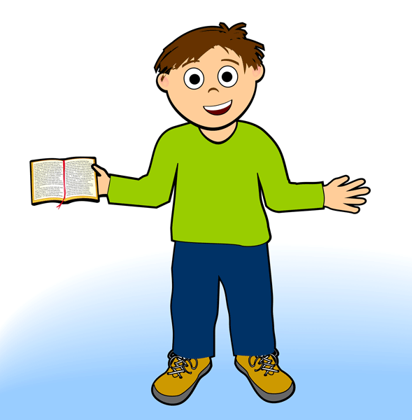
The blessings of paying tithing.
I will give my Tithing to the Mail-Guy (Malachi)
to take to the 3 members of the Bishopric. I promised
when I was baptized (age 8) to pay my 10th.
Notes:
Will a Man Rob God?
You know that statement is talking about Tithing.
One way to pay your Tithing is through the “Mail Guy” Malachi.
At Church, you can only give your tithing to one of the ___ members of the bishopric?
A baptized member (8) promises to pay their 10th.

Slide 43
The Daily Dilemma
Imagine you are asked to teach a brief lesson to one of the older Primary classes in your ward or branch about the Lord’s law of tithing. In your lesson you are asked to address the following three questions:
What is the law of tithing?
What are some of the reasons the Lord has given us this law?
What blessings will we receive from the Lord as we obey the law of tithing?
Spend the next few minutes finding answers to these three questions in Malachi 3:8–10 and in For the Strength of Youth booklet -“Tithes and Offerings”
Be ready to roleplay.

Slide 44
The Daily Dilemma
Marcus recently got a part-time job. He is excited to have his own personal income for the first time in his life, and he already has a lot of plans for how to spend the money he is about to earn. While discussing these plans with him, Marcus’s mother reminds him to be sure to set aside 10 percent of his income for tithing. For some reason, Marcus hadn’t thought of that. He had always found it easy to pay tithing on the smaller amounts of money he had made in the past, but now that the numbers are bigger, he isn’t sure he wants to make the sacrifice it would take to be a regular full-tithe payer. Use the scripture you have learned to share the blessings of paying Tithing.

Slide 45
Malachi 4:5-6
Marriage and Family
5 Behold, I will send you Elijah the prophet before the coming of the great and dreadful day of the Lord:
6 And he shall turn the heart of the fathers to the children, and the heart of the children to their fathers, lest I come and smite the earth with a curse.

Slide 46
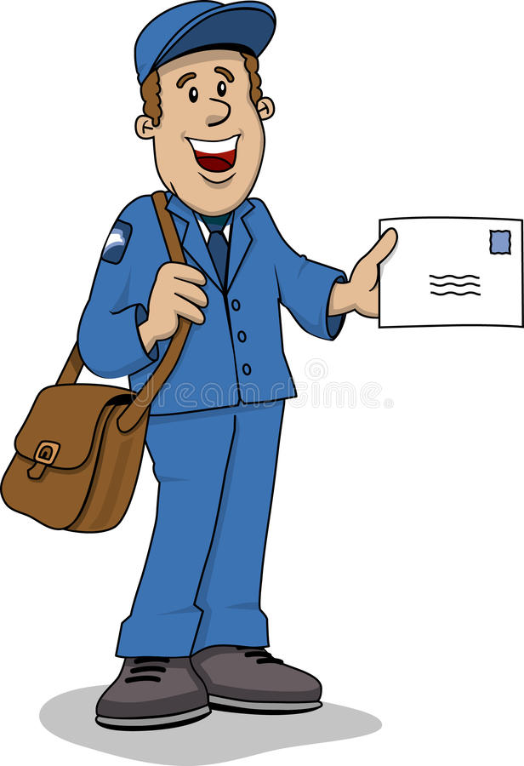
Elijah “shall turn … the heart of the children to their fathers.”
Here’s the Mail-guy ( Malachi ).
I’m going to mail in my
4 generation chart.
Dad, if you really
want to turn your
Heart to your Fathers,
you’ll do your 5th &
6th generations also.
Notes:
Turn Hearts of Father.
Here is a father.
He says…
Did you know we were all asked to compile at least 4 Generations?
4 5 and 6

Slide 47
The Daily Dilemma
What experiences have you had with temple and family history work that have helped you feel a greater connection to your ancestors?
How is doing temple and family history work similar to what the Savior does for us?
Why do you think binding or sealing families together is important to Heavenly Father?
Imagine you have a friend who has recently decided to become a member of the Church. This friend is concerned because her grandparents died without having learned about the restored Church of Jesus Christ. She worries that because they were never baptized, they will not be able to live with God eternally. What could you share with your friend a scripture that could help resolve her concern?

Slide 48
Doctrinal Mastery Reference Quiz
____ “The Lord God . . . revealeth his secret unto his servants the prophets.”
____ Elijah “shall turn . . . the heart of the children to their fathers.”
____ The prophet is “a watchman unto the house of Israel.”
____ The Bible and the Book of Mormon “shall become one in thine hand.”
____ The blessings of paying tithing
____ God shall “set up a kingdom, which shall never be destroyed.”
Ezekiel 3:16-17
Ezekiel 37:15-17
Daniel 2:44-45
Amos 3:7
Malachi 3:8-10
Malachi 4:5-6

